Slide 1



Sampling: Quarterly Visual Monitoring
Documentation, Equipment, The Rules, Why & HOW to perform
To play this presentation and hear the embedded audio, press “F5” from any Windows computer.

Slide 2
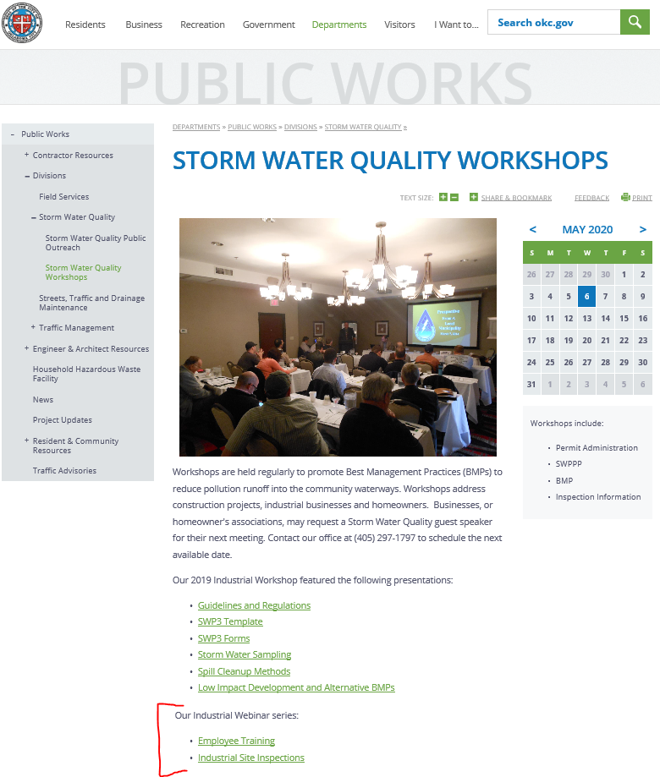
How to view our webinar series
A pre-recorded version of this presentation will be available at: www.okc.gov/departments/public-works/divisions/storm-water-quality/storm-water-quality-workshops after the live event.
  Shortcut: www.okc.gov/swq
  go to Storm Water Quality Workshops
All webinars in this series will be at this website, for playback any time.

Slide 3

Objectives
Topics to be covered in this webinar:
  In-Depth Focus on Quarterly Visual monitoring:
    Why are you doing this & outfall locations
    Site map examples
    Qualifying runoff Events Explained
    Ice & snow melt runoff
    Equipment needed & Sampling procedure
    Required Documentation
    Visual monitoring parameters & Other indicators of pollution
    Adverse weather conditions
    Representative outfalls
    Demonstration video

Slide 4
Quarterly Visual Monitoring
All Industrial Storm Water Discharge Permittees

Slide 5
Why are you doing this?
All industries that have Industrial storm water discharge permits are required to perform Visual Monitoring at least once per calendar quarter.
Provides visual documentation of whether your pollution prevention plan And Best Management Practices are effective.

Slide 6
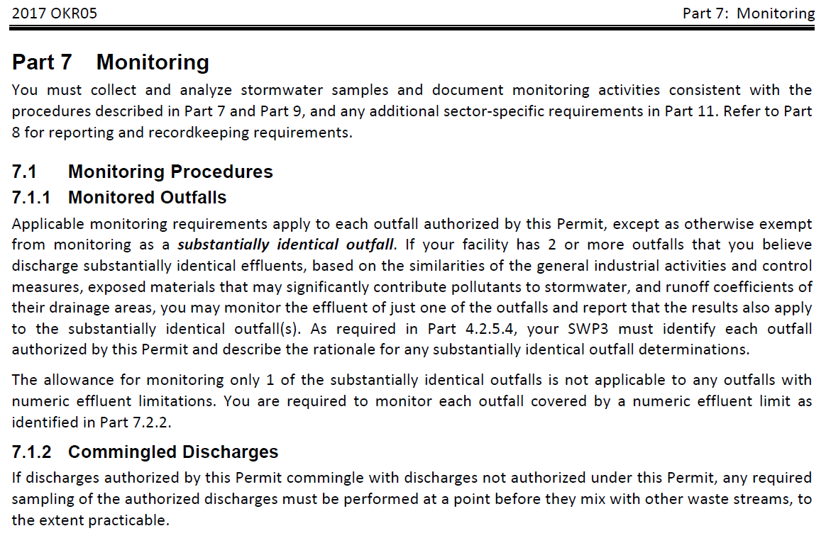
Why are you doing this?

Slide 7
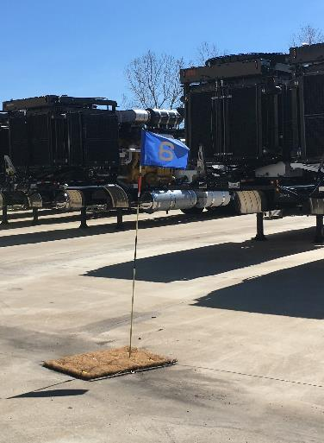
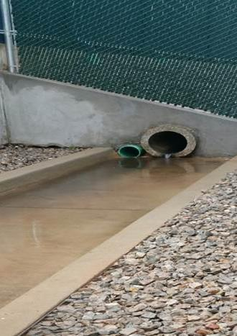
Where is Your outfall?
An outfall refers to any and all areas where storm water discharges from your facility.
  There could be several, depending on the layout of your facility
Outfall(s) at your facility must be indicated on your facility’s site map.
  If you are developing a new site map, you may need to walk the facility during a rain event in order to determine outfall locations.
If you have more than one outfall, each outfall will be required to be monitored separately* - - EACH calendar quarter.
Outfalls must be numbered sequentially in this format:
  001, 002, 003, etc.

Slide 8
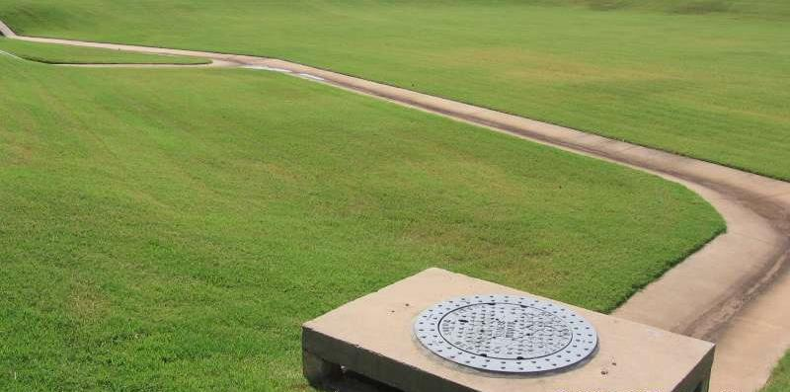
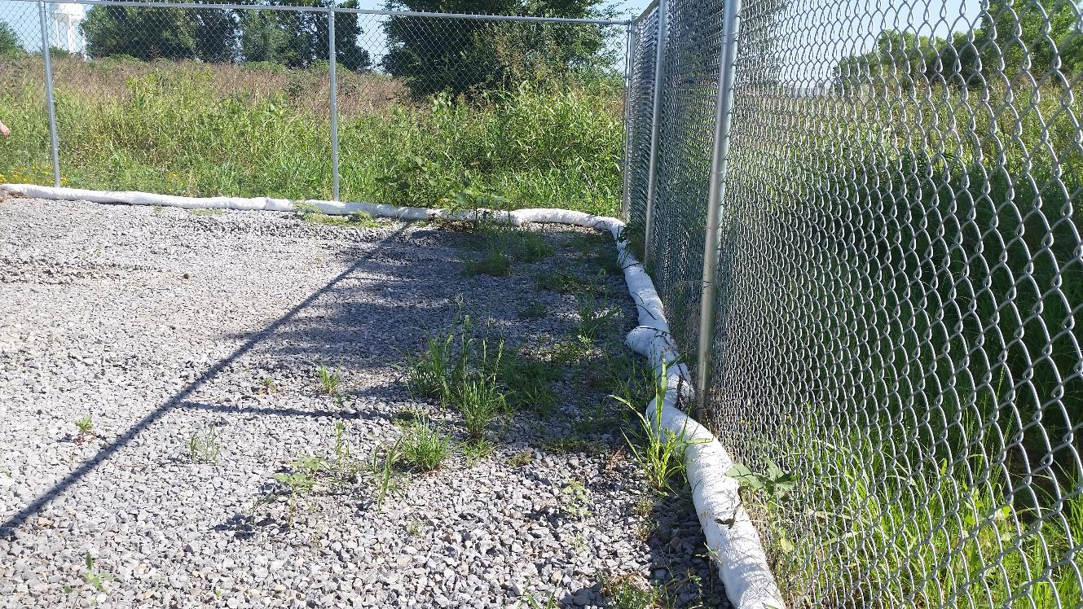
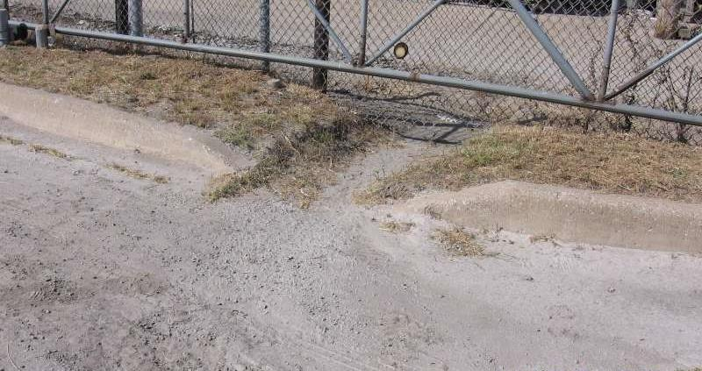
Where is Your outfall?

Slide 9
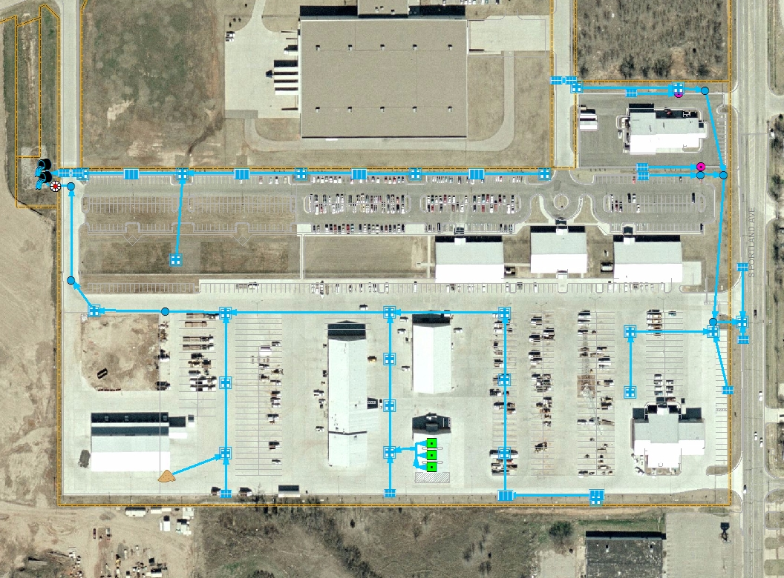
Discharges To: Oklahoma River
Outfall 002
Outfall 001
Outfall 003
All of the surface water draining from this facility’s property will eventually discharge into the North Canadian (Oklahoma) River through many different flow routes.

Slide 10
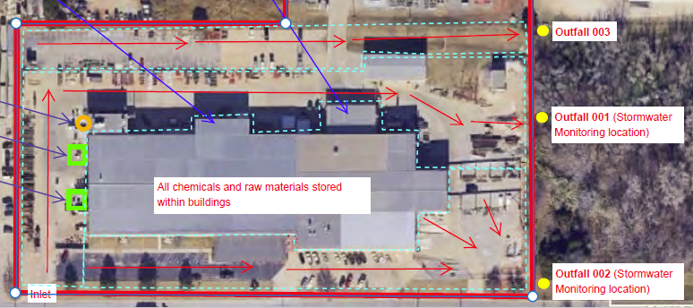

Slide 11
Qualifying Runoff Events –
The Rules
Collect samples within 30-60 minutes after RUNOFF begins discharging from your facility at the outfall area(s).
  The goal: collect the FIRST FLUSH of pollutants and rainwater leaving your facility.
  If samples not collected within the first 30 minutes, must document why not.
Collect samples during regular working and daylight hours.
  Facilities operating for extended hours/shifts must have personnel trained and available to collect samples during those operational periods (daylight only).
Rainfall event must total at least 0.10 inches of rain.
Must be at least 72 hours from a previous measurable runoff event.
  Measurable means 0.10 inches or more of rain.

Slide 12
Ice and Snow Melt Runoff
Frozen precipitation may be collected once melting begins.
  Indicate the correct choice on the Quarterly Visual Monitoring form.
Collect samples during a period with measurable discharge.
  The goal: collect the FIRST FLUSH of pollutants (if any) and melted water leaving your facility.
  First day of melted runoff only!
Collect samples during regular working and daylight hours.
  Facilities operating for extended hours/shifts must have personnel trained and available to collect samples during those operational periods (daylight only).

Slide 13
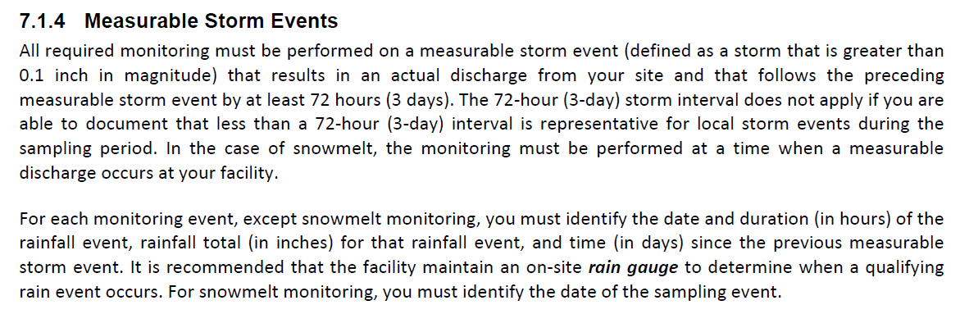
Qualifying Runoff Events –
The Rules

Slide 14
Equipment Needed
Boots, waders, or clothes that you do not mind getting wet and dirty.
  Rain gear?
Collection container (such as a plastic bottle/jug with the top cut off)
Clean observation container(s) such as a clear two-liter bottle, mason jar, or other clear container(s).
  One per outfall – make sure they’re labeled with the outfall number!
Quarterly Visual Monitoring Report form and a pen/pencil
Specialized equipment may include:
  Swimming pool extension pole for reaching into flowing water
  Waterproof paper, Write-in-the-rain pen
  Latex gloves and other protective safety gear (eye protection, life vest, etc.)
  Laminated site map with outfall numbers and locations

Slide 15
Sampling Procedure
Have a separate, clean/CLEAR observation container labeled for each outfall (glass or plastic).
Utilize a clean collection container to collect samples and immediately dispense the sample into the observation container.
  While dipping the collection container into the water flow, make certain that the container is not completely submerged.
    This allows any floating materials to also be collected.
  Do not scoop sediment from the bottom of the sampling location.
  Collect approximately 500mL (about a quart) of water for each.
  Rinse the collection container prior to sampling the next outfall, if there are multiple outfalls at your facility.
Once all collection and observation activities have been completed and documented, wash, rinse, and dry ALL your sampling equipment to be ready for the next qualifying event.

Slide 16
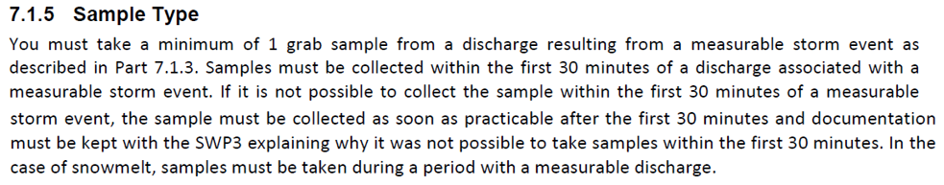
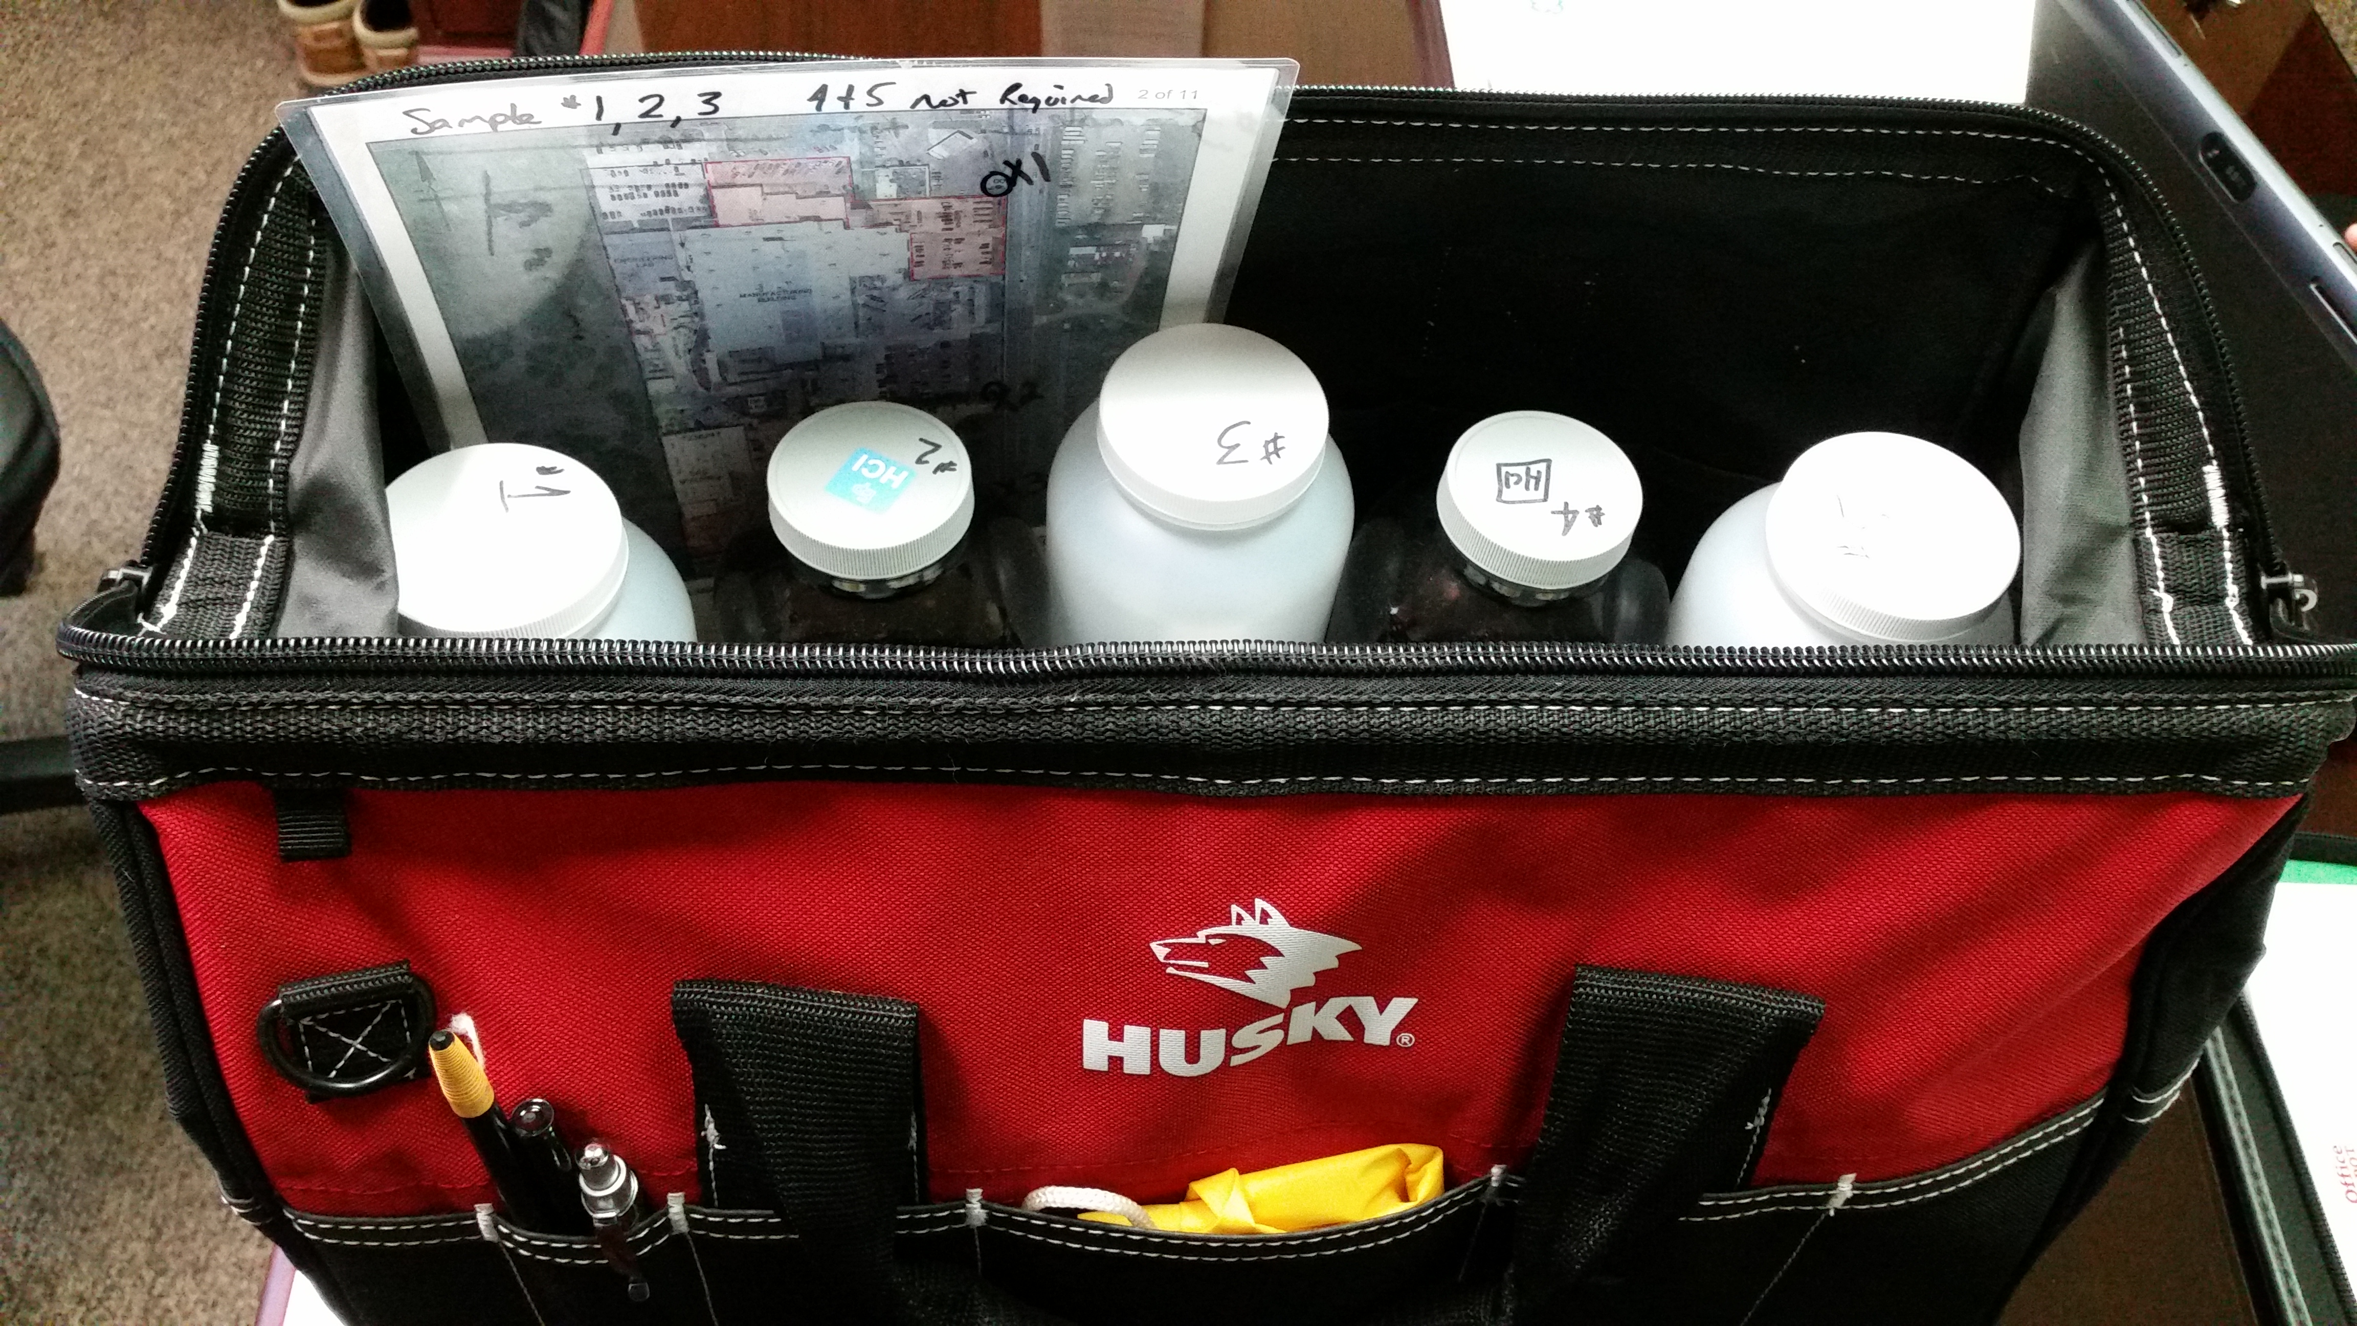
Grab Sample Collection

Slide 17
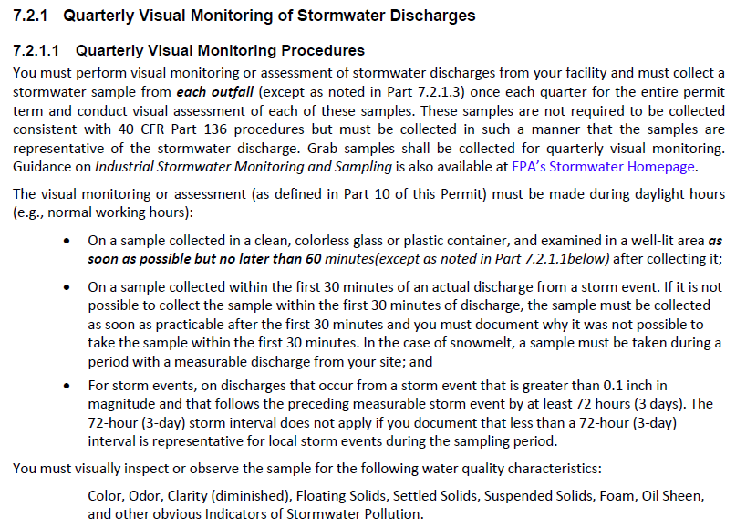
Sampling Procedure

Slide 18
Documentation
Quarterly Visual Monitoring Report form.
  DEQ Template: Document one outfall per page
  OKC template: room for up to seven (7) outfalls on one page
Document all quarters and outfalls – sampled or not (and why).
Keep all records in the SWP3.
Corrective Actions, for any problems found, must be documented onto Corrective Action form.
If applicable, document why it was not possible to take samples within the first 30 minutes after runoff begins (First Flush).
  Encourages permittees to sample the First Flush!
  No “spot” for this on the DEQ Template form, just write it in.
Document probable sources of observed contamination.
If no qualifying storm event occurs in a calendar quarter, documentation must be included, signed and certified into the SWP3.

Slide 19
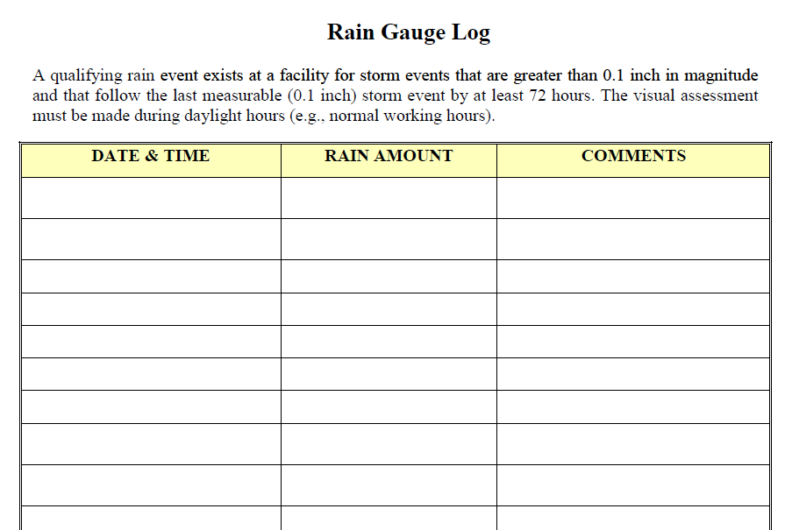
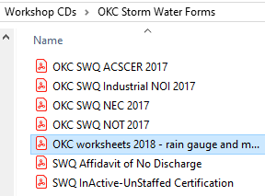
Rain Gauge Log, Optional form
Available on your workshop
CD or from your inspector.

Slide 20
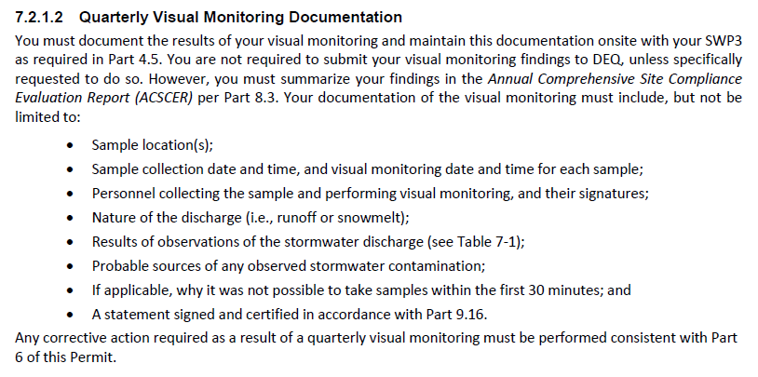
Documentation

Slide 21
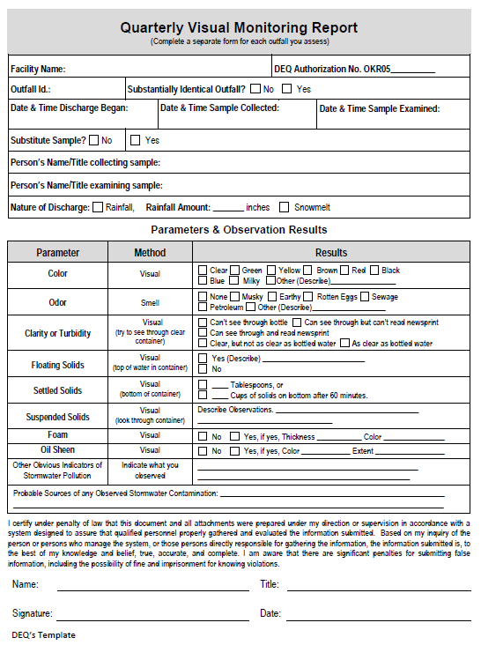
Documentation
DEQ TEMPLATE
Note: you must add comments
regarding why you weren’t
able to collect samples within the first 30 minutes, if applicable.
Don’t forget to document any probable sources of observed contamination.
Notes:
DEQ Form, one outfall only.

Slide 22
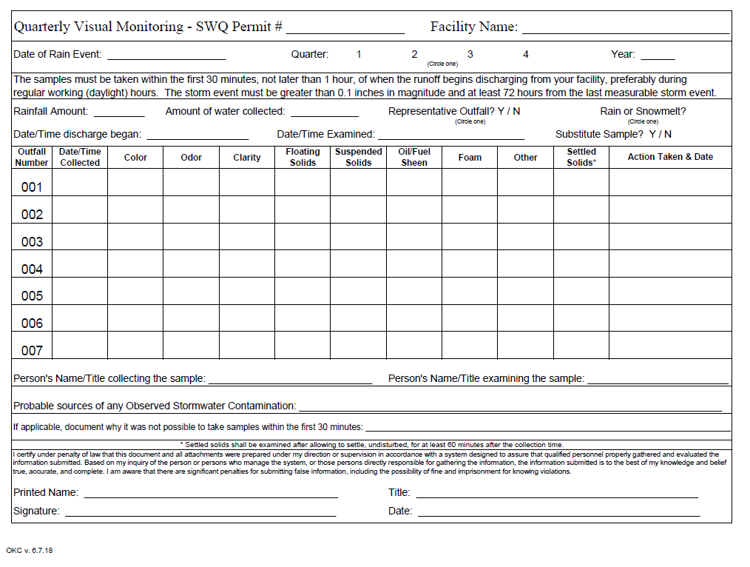
Documentation – OKC Template
Notes:
Alternative Visual Monitoring form, created by OKC SWQ. For use with facilities having multiple outfalls.

Slide 23
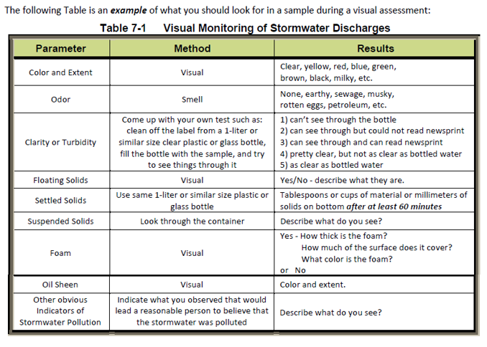
Visual Monitoring Parameters

Slide 24
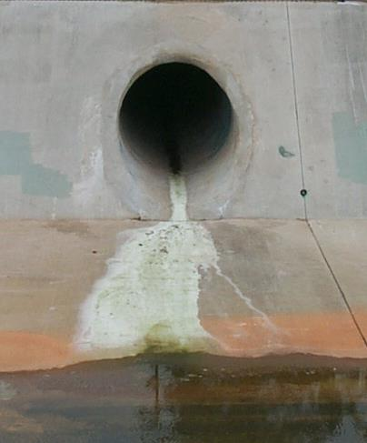
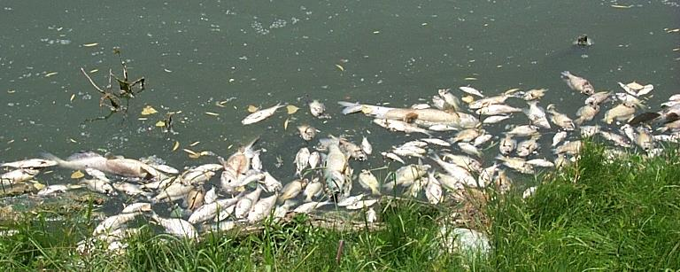
Other Indicators of Pollution
Indicate what was observed that would lead a reasonable person to believe that the storm water runoff was polluted.
Examples:
  Excessive trash (Blowables or illegal dumping)
  Excessive surface scum
  Discolored outfalls
  Dead Fish/Animals

Slide 25
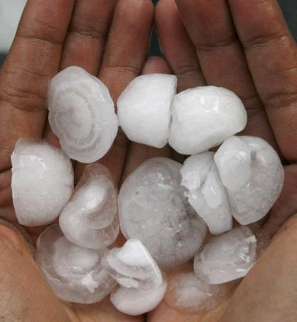
Adverse Weather Conditions
When adverse weather conditions prevent the collection of samples during a calendar quarter, you must take a substitute sample during the next qualifying event.
Adverse conditions potentially creating a dangerous situation, inaccessibility, or impracticability:
  Local flooding
  High Winds
  Electrical storms
  Hail
  Tornado
  Extended frozen conditions
  Drought
You must document any failure to monitor and indicate the reason.

Slide 26
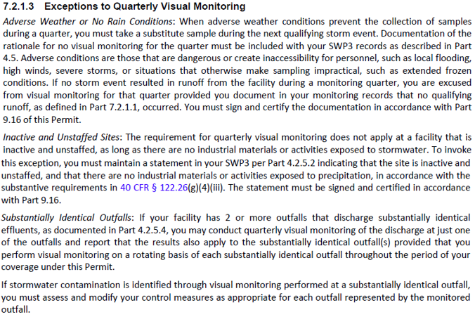
Exceptions to Quarterly Visual Monitoring

Slide 27
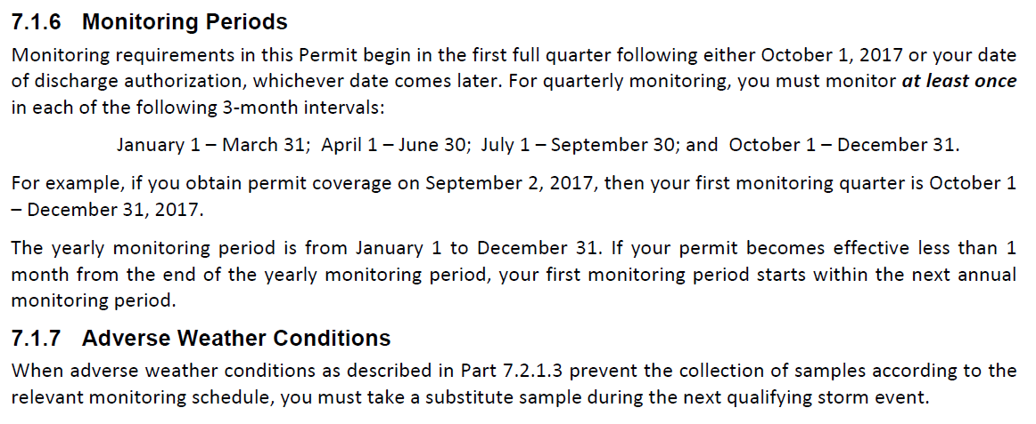
Monitoring Periods & Adverse Weather conditions

Slide 28
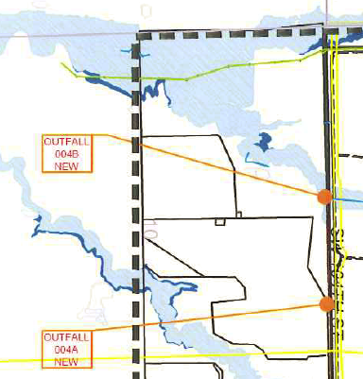
*Representative Outfalls aka Substantially identical effluents
If your facility has two or more outfalls and the following apply:
  Discharges consist of substantially identical effluents (Runoff looks the same), and
  Similar industrial activities and control measures exist in the areas being compared (similar activities in each area), and
  Similar exposed materials may contribute pollutants to storm water runoff in the areas being compared (similar materials in each area), and
  Similar runoff coefficients of the outfalls’ drainage areas.
    “Runoff Coefficient means the fraction of total rainfall that will appear at the conveyance (outfall) as runoff.” (i.e.: similar area in size with similar amounts of impervious surfaces)
If each of the above situations is true, and you have shown through previous quarterly visual monitoring results that the above is true, then you may apply for an allowance to monitor the outfalls on a rotating basis for quarterly visual monitoring.
Be aware: if contamination is found at the representative sampling point, control measures must be assessed and modified for each outfall represented by the monitored one.
Quick guide on Runoff Coefficients: www.waterboards.ca.gov/water_issues/programs/swamp/docs/cwt/guidance/513.pdf

Slide 29
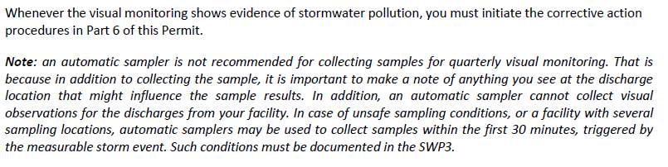
Additional Notes – OKR05
These notes immediately follow Table 7-1, Visual Monitoring of Stormwater Discharges, in the OKR05:

Slide 30
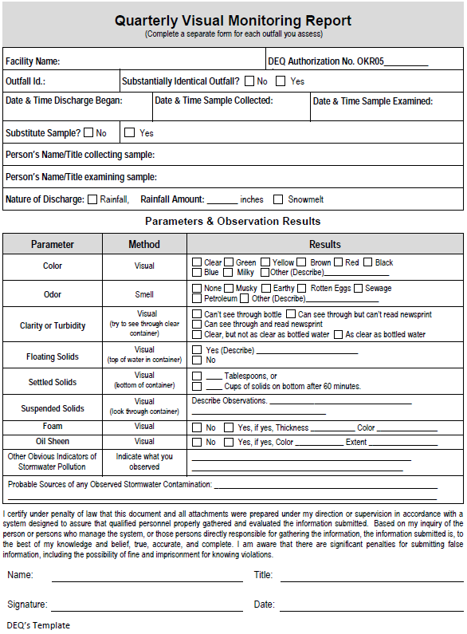
VIDEO – Quarterly Visual
Monitoring, changes:
Keep all records for at least three (3) years from the date that your coverage under the OKR05 permit expires or is terminated
Form has changed, use new form as described in this presentation
Settled Solids to be measured after “at least 60 minutes”

Slide 31
VIDEO – Quarterly Visual Monitoring
File is too large with video attached
Video is available online at:
www.youtube.com/watch?v=THI7Xsbvaj4&feature=youtu.be

Slide 32

For more information:
www.okc.gov/SWQ
www.deq.ok.gov
www.epa.gov
Questions? email: rebecca.dallen@okc.gov
Notes:
Image credit: Getty Images

