Slide 1


Storm Water
Sampling - NELM
Effluent Limitations guidelines
Aka Numeric Effluent limitation monitoring (NELM),
Sector-Specific Analytical monitoring
To play this presentation and hear the embedded audio, press “F5” from any Windows computer.

Slide 2
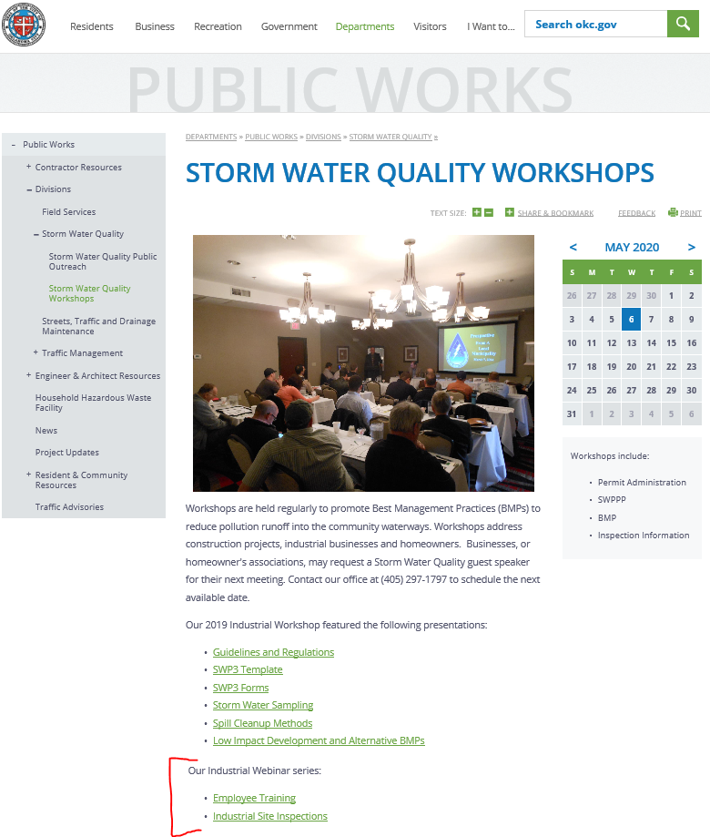
How to view our webinar series
A pre-recorded version of this presentation will be available at: www.okc.gov/departments/public-works/divisions/storm-water-quality/storm-water-quality-workshops after the live event.
  Shortcut: www.okc.gov/swq
  go to Storm Water Quality Workshops
All webinars in this series will be at this website, for playback any time.

Slide 3
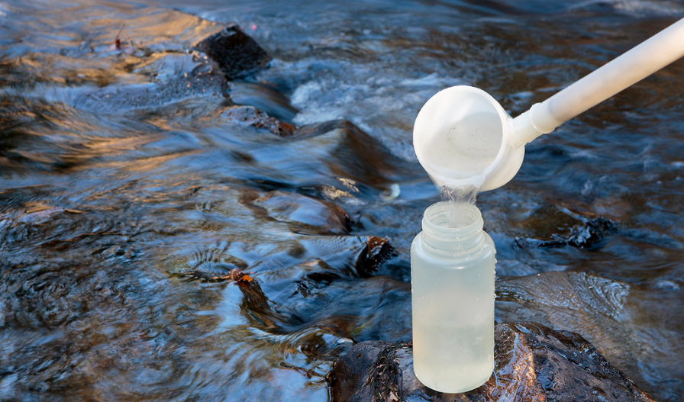
Outline
The Basics:
  Why is this sampling performed?
  Outfall locations & NOI
  Qualifying runoff events
  Ice and snow melt events
  Equipment needed
  Sampling procedures
  Representative outfalls
Analytical Monitoring – tips & labs
Sector-Specific analytical monitoring
  The requirements, OKR05 2017
  Sectors: A, C, D, E, J, K, L, O, S
E-dmr reporting (Electronic Discharge Monitoring Report)
Exceedance – what to do
NOTE: Inactive/unstaffed facilities, No Exposure facilities, and No Discharge facilities (OKC only) are not required to perform ANY monitoring.

Slide 4


The Basics
Why the sampling is performed; Outfall Locations & NOI; Qualifying runoff Events; Ice & Snow Melt; Equipment needed; sampling procedures; representative outfalls

Slide 5
Why are you doing this?
Some facilities that have Industrial storm water discharge permits are required to perform effluent limitations analytical monitoring annually.
Provides more in-depth information regarding whether your pollution prevention plan And Best Management Practices are effective.

Slide 6
Where is my outfall?
An outfall refers to any and all areas where storm water discharges from your facility.
  There could be several, depending on the layout of your facility
Outfall(s) at your facility must be indicated on your facility’s site map.
  If you are developing a new site map, you may need to walk the facility during a rain event in order to determine outfall locations.
  Outfalls must be numbered sequentially in this format:
    001, 002, 003, etc.
If you have more than one outfall, each outfall will be required to be monitored separately

Slide 7
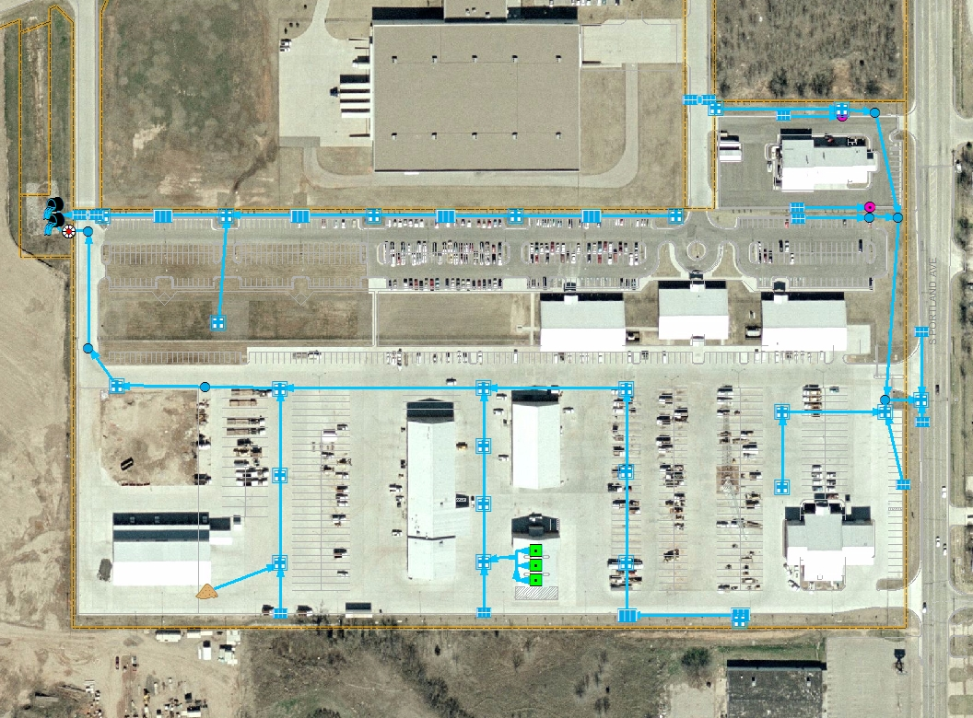
Discharges To: Oklahoma River
Outfall 002
Outfall 001
Outfall 003
All of the surface water draining from this facility’s property will eventually discharge into the North Canadian (Oklahoma) River through many different flow routes.

Slide 8
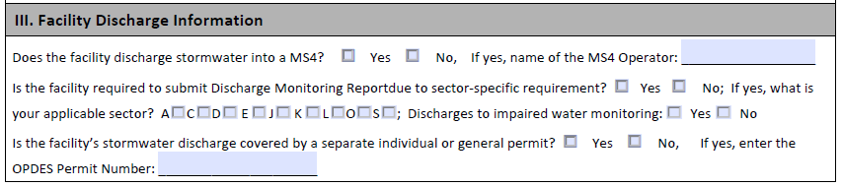

Indicate on NOI
If these monitoring requirements apply to you, be sure to indicate that fact on your Notice of Intent (NOI).
Mark your correct sector.
Example:

Slide 9
Qualifying Runoff Events –
The Rules
Collect samples within 30-60 minutes after RUNOFF begins discharging from your facility at the outfall area(s).
  The goal: collect the FIRST FLUSH of pollutants and rainwater leaving your facility.
  If samples not collected within the first 30 minutes, must document why not.
Collect samples during regular working and daylight hours.
  Facilities operating for extended hours/shifts must have personnel trained and available to collect samples during those operational periods (daylight only).
Rainfall event must total at least 0.10 inches of rain.
Must be at least 72 hours from a previous measurable runoff event.
  Measurable means 0.10 inches or more of rain.

Slide 10
Ice and Snow Melt Runoff
THERE May not be enough flow from this type of runoff, to provide adequate sample volume for analytical monitoring requirements.
Frozen precipitation may be collected once melting begins.
  Indicate the correct choice on the Quarterly Visual Monitoring form.
Collect samples during a period with measurable discharge.
  The goal: collect the FIRST FLUSH of pollutants (if any) and melted water leaving your facility.
  First day of melted runoff only!
Collect samples during regular working and daylight hours.
  Facilities operating for extended hours/shifts must have personnel trained and available to collect samples during those operational periods (daylight only).

Slide 11
Equipment Needed
Sample containers from a certified laboratory, for each required test
  Typically One container per outfall, per analytical test – make sure the labels are complete, including the outfall number.
Laboratory ice chest and ice for collected samples.
Boots, waders, or clothes that you do not mind getting wet and dirty.
  Rain gear?
Clean Collection container (such as a plastic bottle/jug with the top cut off):
  Collection container must be thoroughly cleaned before use, in order to not contaminate samples.
  Be especially vigilant when collecting samples for bacterial analysis.
Chain of custody form and a pen/pencil
Specialized equipment may include:
  Swimming pool extension pole for reaching into flowing water
  Latex gloves and other protective safety gear (eye protection, life vest, etc.)
  Waterproof paper

Slide 12
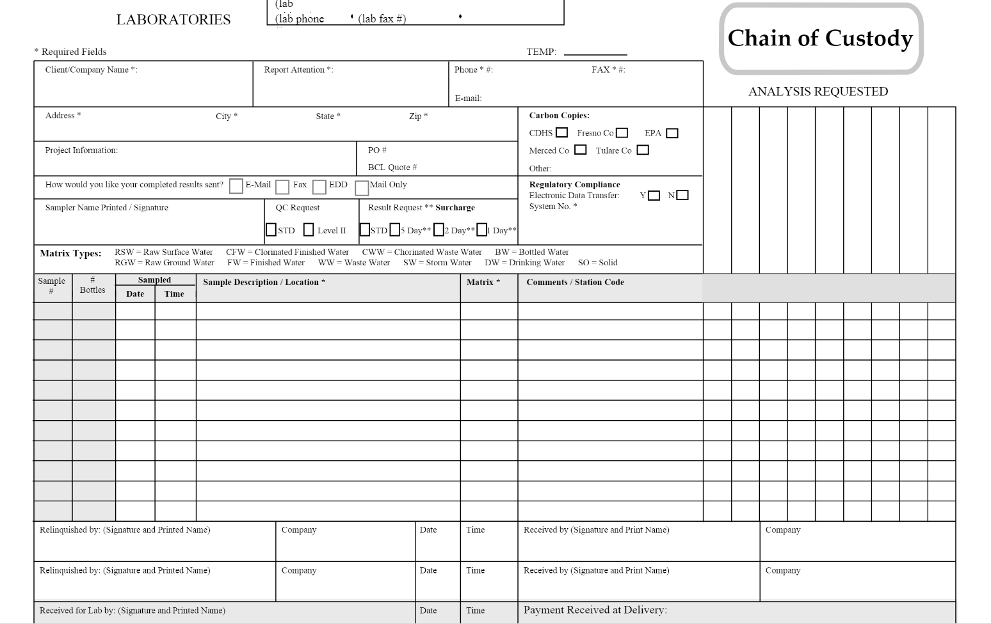

Slide 13
Sampling Procedure
Have laboratory sample containers ready.
Utilize a clean collection container to collect samples and immediately dispense the sample into the laboratory container(s).
  While dipping the collection container into the water flow, make certain that the container is not completely submerged.
    This allows any floating materials to also be collected.
  Do not scoop sediment from the bottom of the sampling location.
  Collect the required amount for each sample.
    Follow lab instructions on filling containers to the proper volume.
  clean the collection container prior to sampling the next outfall, if there are multiple outfalls at your facility.
Once all sampling activities have been completed, place collected samples into ice chest and add ice to the chest to cool the samples.
  Complete the chain-of-custody form.
  Ship or deliver the ice chest to the contracted lab asap.

Slide 14
Representative Outfalls & Analytical Monitoring
With any required ANALYTICAL MONITORING, all outfalls must be sampled.
Cannot “skip” an outfall due to representative outfalls
  Representative outfalls utilized for quarterly visual monitoring only

Slide 15
Analytical monitoring
Rules and reminders;
pH;
Local laboratories

Slide 16
Effluent Limitations Sampling
Analyticals are in addition to quarterly visual monitoring for the affected business types (aka sectors).
  In some cases, not all SIC Codes included in the Sector must perform analyticals. See OKR05 for more information.
Must sample all outfalls, regardless of “representative” outfall status.
Analyticals are to be performed once per calendar year.
Report results by January 15 of the following year, on the electronic Discharge monitoring report (e-DMR) form to DEQ.
Provide a copy of the lab results &/or the dmr to your OKC SWQ inspector.

Slide 17
Laboratory reminders
Must use certified lab, or calibrated meters
  Must comply with 40 CFR Part 136 methods
Obtain sampling kit before-hand:
  Glass/plastic bottles
  Clear/amber bottles
  May require additive for preservation (could be caustic)
  Fill sample container to proper level, do not overfill
Properly label bottles
Bottles into ice chest, with ice, for transportation to lab ASAP
Complete Chain-of-Custody form
Notes:
https://www.deq.ok.gov/divisions/sels/

Slide 18
pH
Must be examined “immediately” onsite.
  sample must be analyzed within 15 minutes of collection.
DEQ has stated that “[The] permit doesn’t require or restrict to use their own meter. However, the permittee is required to follow the sampling and testing procedures of 40 CFR Part 136….”
40 CFR Part 136 states that the acceptable methods include electrometric measurement and automated electrode.
Link: www.law.cornell.edu/cfr/text/40/part-136

Slide 19
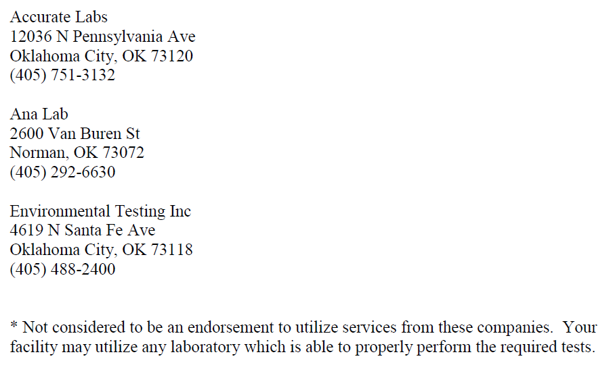
LOCAL Available Labs*
DEQ’s Lab
  www.deq.ok.gov/divisions/sels
  707 N. Robinson Ave
  Oklahoma City, OK 73102
  866-412-3057 or 405-702-1000
Red River Environmental Lab
  6510 S. Western Ave
  Oklahoma City, OK 73139
  405-232-1966

Slide 20
Sector-Specific Analytical Monitoring
  OKR05 Sectors: A, C, D, E, J, K, L, O, S
www.deq.ok.gov/water-quality-division/wastewater-stormwater/stormwater-permitting/okr05-industrial-stormwater

Slide 21
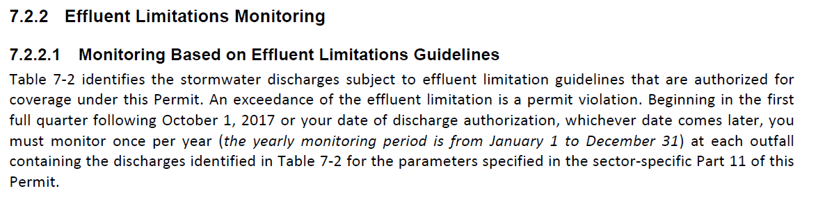
2017 OKR05 – Effluent Limitations monitoring
www.deq.ok.gov/water-quality-division/wastewater-stormwater/stormwater-permitting/okr05-industrial-stormwater

Slide 22
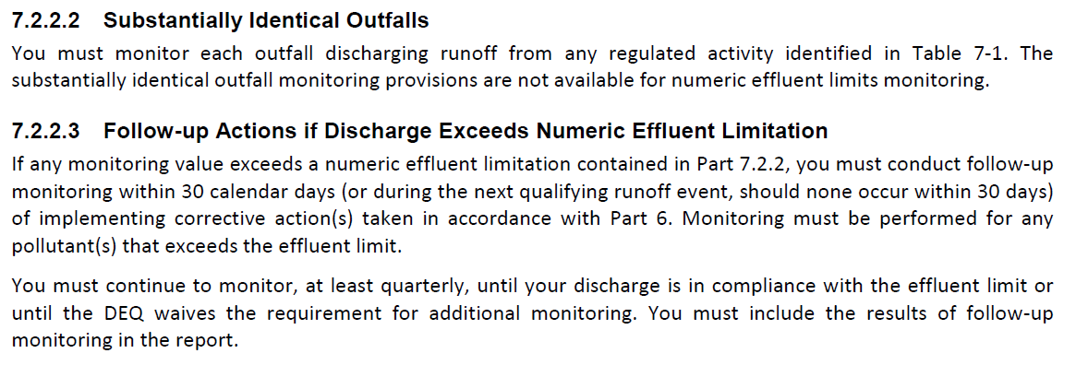
2017 OKR05 – Effluent Limitations monitoring
Note: An exceedance is a condition which triggers Corrective Action Reporting.
www.deq.ok.gov/water-quality-division/wastewater-stormwater/stormwater-permitting/okr05-industrial-stormwater

Slide 23
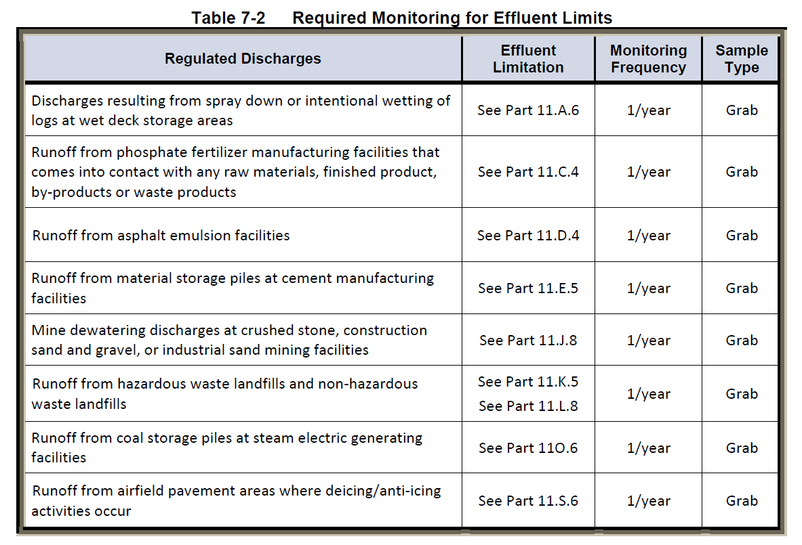
2017 OKR05, Table 7-2
www.deq.ok.gov/water-quality-division/wastewater-stormwater/stormwater-permitting/okr05-industrial-stormwater

Slide 24
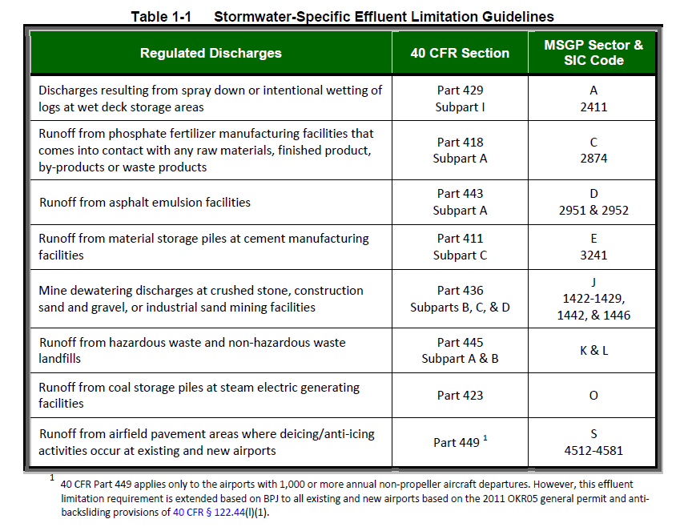
2017 OKR05, Table 1-1
Link: www.law.cornell.edu/cfr/text/40/122.44

Slide 25
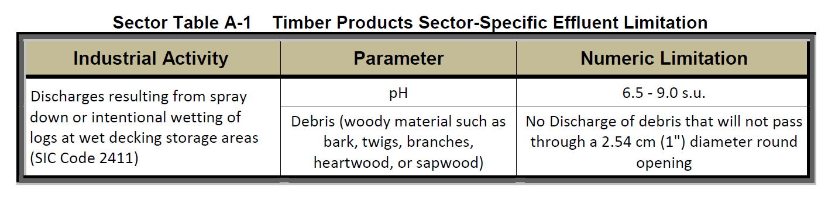
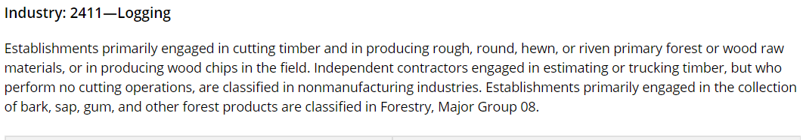
Sector A – Timber Products
Link: www.law.cornell.edu/cfr/text/40/part-429/subpart-I

Slide 26
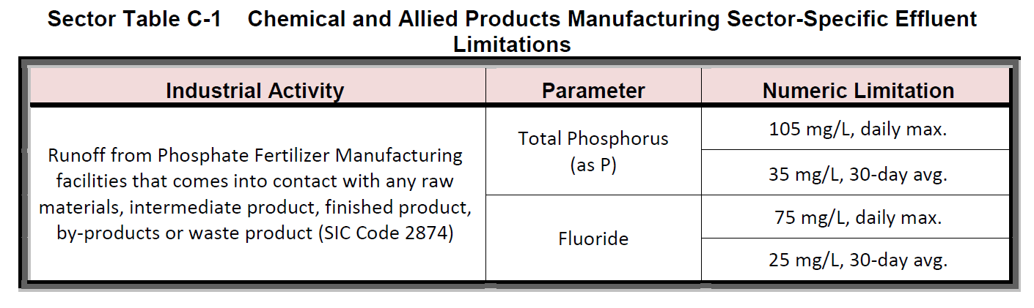
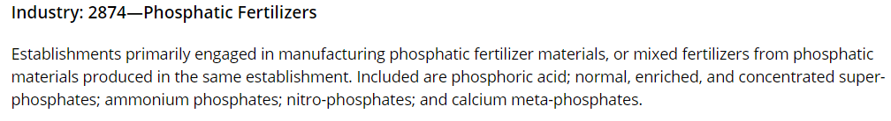
Sector C – Chemical and Allied Products Manufacturing
Link: www.law.cornell.edu/cfr/text/40/part-418/subpart-A

Slide 27
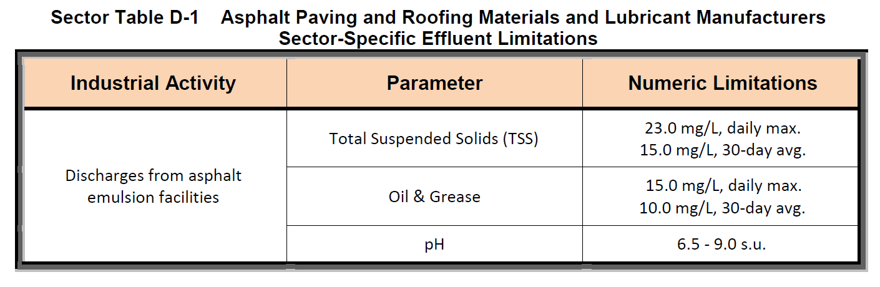
Sector D - Asphalt Paving and Roofing Materials and Lubricant Manufacturers
Link: www.law.cornell.edu/cfr/text/40/part-443/subpart-A

Slide 28
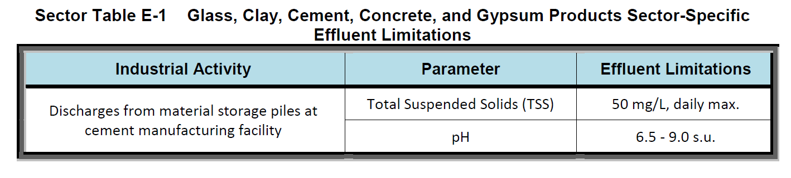
Sector E - Glass, Clay, Cement, Concrete, and Gypsum Products
Link: www.law.cornell.edu/cfr/text/40/part-411/subpart-C

Slide 29
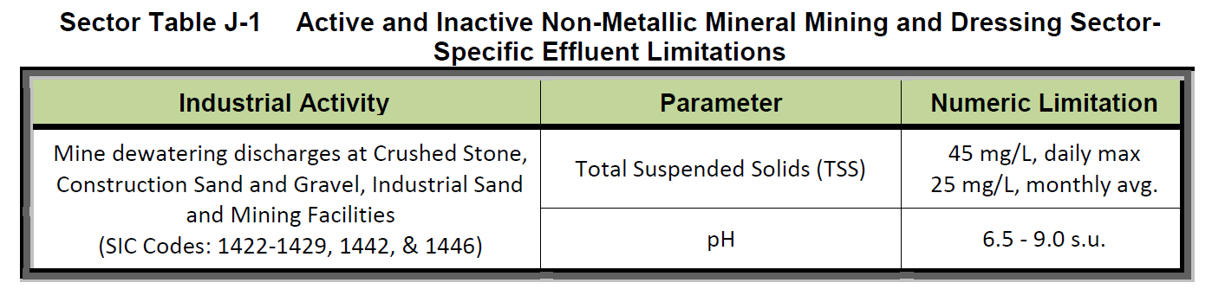
Sector J - Mineral Mining and Dressing
Links: www.law.cornell.edu/cfr/text/40/part-436/subpart-B
www.law.cornell.edu/cfr/text/40/part-436/subpart-C
www.law.cornell.edu/cfr/text/40/part-436/subpart-D

Slide 30
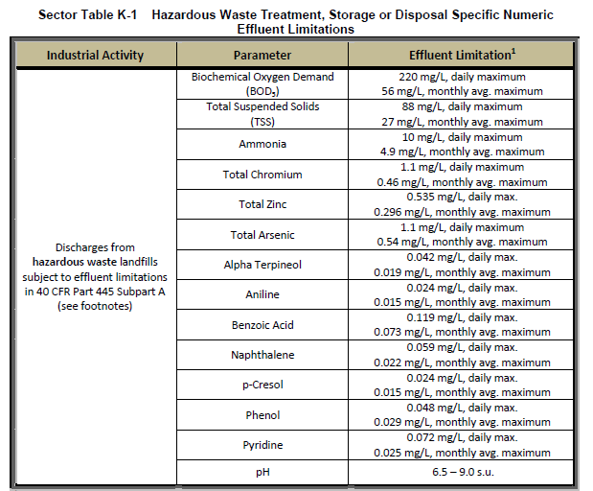
Sector K - Hazardous Waste Treatment, Storage, or Disposal Facilities
Link:
www.law.cornell.edu/cfr/text/40/part-445/subpart-A

Slide 31
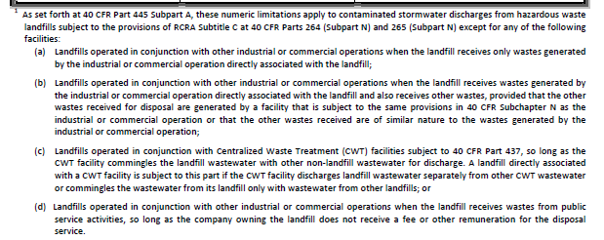
Sector K - Hazardous Waste Treatment, Storage, or Disposal Facilities, CONT.
Links: www.law.cornell.edu/cfr/text/40/part-445/subpart-A
www.law.cornell.edu/cfr/text/40/part-264/subpart-N
www.law.cornell.edu/cfr/text/40/part-265/subpart-N
www.law.cornell.edu/cfr/text/40/part-437

Slide 32
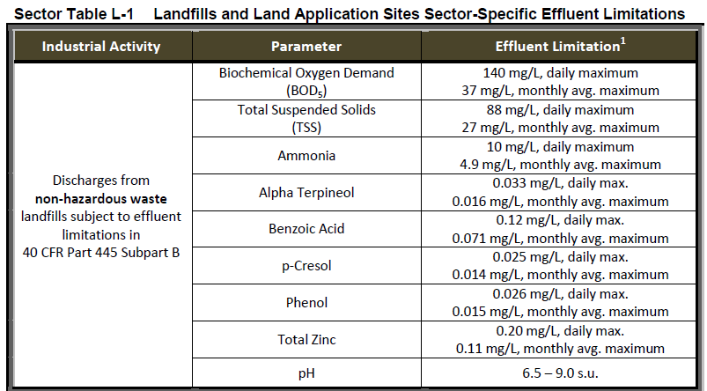
Sector L – Landfills, Land Application Sites, and Open Dumps
Link: www.law.cornell.edu/cfr/text/40/part-445/subpart-B

Slide 33
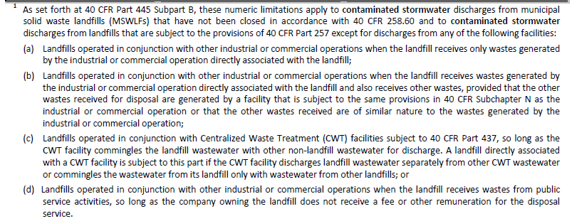
Sector L – Landfills, Land Application Sites, and Open Dumps, Continued
Links: www.law.cornell.edu/cfr/text/40/part-445/subpart-B
www.law.cornell.edu/cfr/text/40/258.60
www.law.cornell.edu/cfr/text/40/part-257
www.law.cornell.edu/cfr/text/40/chapter-I/subchapter-N
www.law.cornell.edu/cfr/text/40/part-437

Slide 34
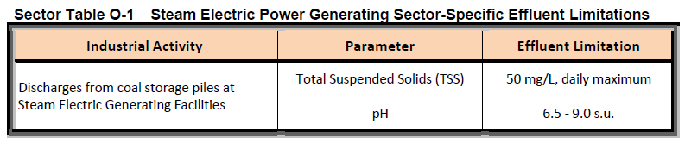
Sector O – Steam Electric Generating Facilities
Link: www.law.cornell.edu/cfr/text/40/part-423

Slide 35
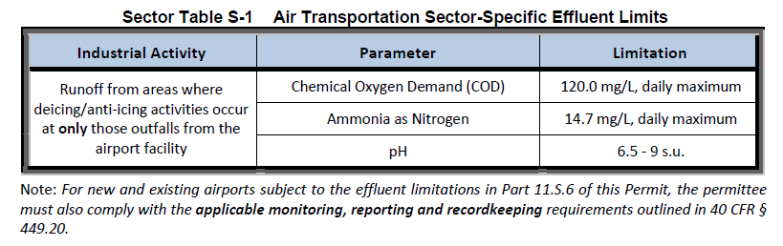
Sector S – Air Transportation
Links: www.law.cornell.edu/cfr/text/40/449.20
www.law.cornell.edu/cfr/text/40/part-449

Slide 36
E-dmr
  Online E-dmr Reporting
  Report filed with DEQ Annually for Effluent Limitations Guidelines monitoring – Due January 15th
https://applications.deq.ok.gov/E2/Pages/Main/Login.aspx?ReturnUrl=%2fe2%2fdefault.aspx

Slide 37
Online DMR Reporting
DEQ requires online DMR reporting for all analytical lab testing performed.
All monitoring data collected must be submitted to DEQ using the Discharge Monitoring Report (DMR) form no later than 15th day of the month after the end of the reporting period.
  For annual parameters, such as NELMs, Reports are due January 15th
  If your facility doesn’t have any discharge during the year, you are still required to submit a DMR to DEQ stating no discharge each year by January 15.
You must also submit your Lab results to the City of Oklahoma City.
  Provide a photocopy of the DMR or lab results to your inspector during your audit, or you can email us a copy of the lab results when you receive them from the laboratory.
https://applications.deq.ok.gov/E2/Pages/Main/Login.aspx?ReturnUrl=%2fe2%2fdefault.aspx

Slide 38
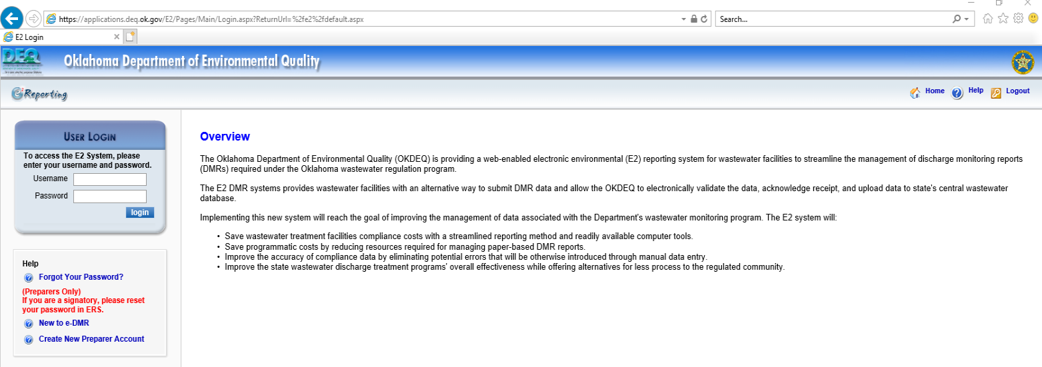
Online DMR Reporting
Instructions on how to register as a Preparer or Signatory for electronic DMR (eDMR), as well as how to prepare and submit e-DMR, can be found on DEQ’s website:
  https://applications.deq.ok.gov/E2/Pages/Main/Login.aspx?ReturnUrl=%2fe2%2fdefault.aspx
  Assistance is also available by contacting DEQ at (405) 702-1000 or 1-800-869-1400 or deqreporting@deq.ok.gov .
E-DMR is required for all analytical monitoring being reported to the State, including stormwater and wastewater analytical monitoring.
Notes:
https://applications.deq.ok.gov/E2/Pages/Main/Login.aspx?ReturnUrl=%2fe2%2fdefault.aspx

Slide 39
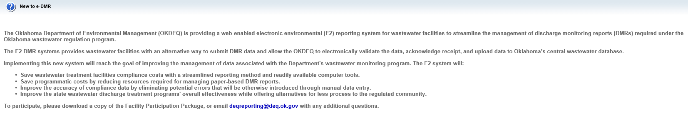
Online DMR Reporting
The Oklahoma Department of Environmental Management (OKDEQ) is providing a web-enabled electronic environmental (E2) reporting system for wastewater facilities to streamline the management of discharge monitoring reports (DMRs) required under the Oklahoma wastewater regulation program.
The E2 DMR systems provides wastewater facilities with an alternative way to submit DMR data and allow the OKDEQ to electronically validate the data, acknowledge receipt, and upload data to Oklahoma’s central wastewater database.
Implementing this new system will reach the goal of improving the management of data associated with the Department's wastewater monitoring program. The E2 system will:
  Save wastewater treatment facilities compliance costs with a streamlined reporting method and readily available computer tools.
  Save programmatic costs by reducing resources required for managing paper-based DMR reports.
  Improve the accuracy of compliance data by eliminating potential errors that will be otherwise introduced through manual data entry.
  Improve the state wastewater discharge treatment programs' overall effectiveness while offering alternatives for less process to the regulated community.
To participate, please download a copy of the Facility Participation Package, or email deqreporting@deq.ok.gov with any additional questions.

Slide 40
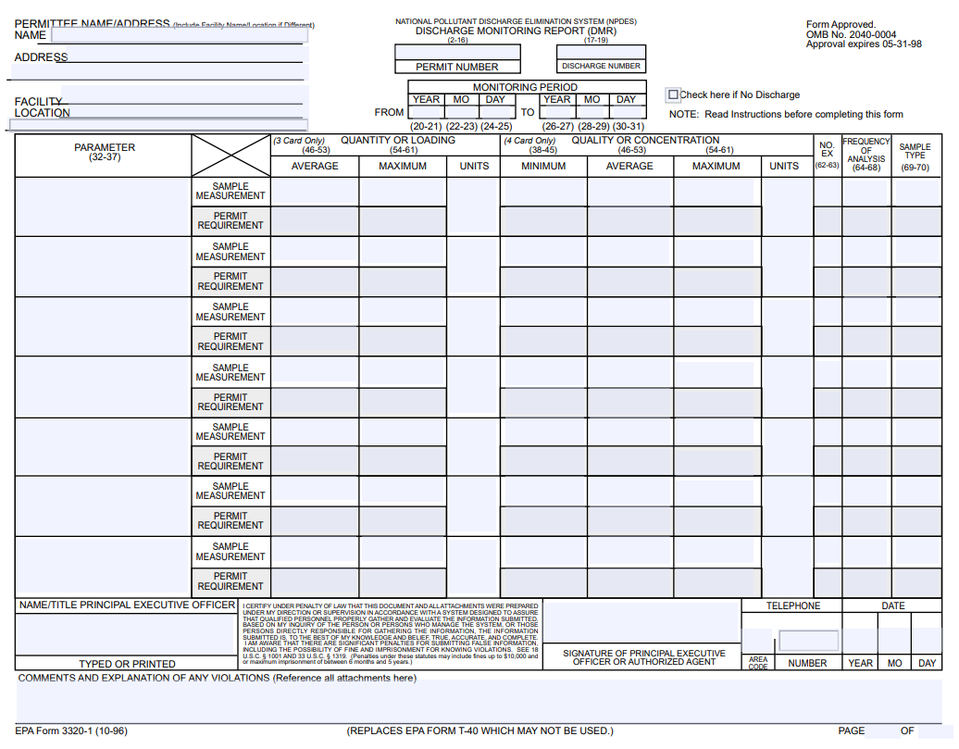

Slide 41
Example DMR

Slide 42
Example lab results – raw data
BPQL = Below Practical Quantitation Limit
PQL = Practical Quantitation Limit

Slide 43
ExCeedance
  What to do if your analytical results are outside the stated limits

Slide 44
Exceedance – what to do
You must conduct follow-up monitoring within 30 calendar days, or during the next qualifying runoff event, of implementing corrective actions taken in response to an exceedance of a numeric effluent limit.
Follow-up monitoring must be performed for any and all pollutant(s) that exceed the effluent limits listed in the OKR05.
You must continue to monitor, at least quarterly, until your discharge is in compliance with the effluent limit or until the ODEQ waives the requirement for additional monitoring.
You must include the results of follow-up monitoring in your report.

Slide 45
2017 OKR05 – Effluent Limitations monitoring, Exceedance
Note: An exceedance is a condition which triggers Corrective Action Reporting.
www.deq.ok.gov/water-quality-division/wastewater-stormwater/stormwater-permitting/okr05-industrial-stormwater

Slide 46

For more information:
www.okc.gov/SWQ
www.deq.ok.gov
www.epa.gov
To request a Certificate of Attendance for the live event,
or for any questions, email : rebecca.dallen@okc.gov
Notes:
Image credit: Getty Images

