Slide 1
Industrial Facility Site Inspections
What to expect, look for & document
To play this presentation and hear the embedded audio, press “F5” from any Windows computer.

Slide 2
How to view our webinar series
A pre-recorded version of this presentation will be available at: www.okc.gov/departments/public-works/divisions/storm-water-quality/storm-water-quality-workshops after the live event.
Shortcut: www.okc.gov/swq then go to Storm Water Quality Workshops
All webinars in this series will be at this website, for playback any time.

Slide 3
Objectives
Topics to be covered in this webinar:
Industrial Stormwater & MSGP defined
Requirements regarding site inspections
EPA MSGP
OKR05 (Oklahoma MSGP)
Frequency
Sector-Specific requirements
Site inspection documentation
General Guideline for site inspections
Site examples of what to look for
Record retention
DEQ FAQ’s

Slide 4
Industrial Stormwater & MSGP Defined

Slide 5
What is Industrial stormwater?
Industrial stormwater is runoff from precipitation (rain, snow, sleet, freezing rain, or hail) that lands on industrial sites (e.g. manufacturing facilities, mines, airports).
This runoff is often polluted by materials that are handled or stored on the sites, and the facilities are subject to regulations to control the discharges.
In the United States, facilities that discharge industrial stormwater to surface waters must obtain a permit under the National Pollutant Discharge Elimination System (NPDES), pursuant to the Clean Water Act.
Stormwater permit regulations issued by the United States Environmental Protection Agency (EPA) govern the permit process.
Source: www.en.wikipedia.org/wiki/Industrial_stormwater

Slide 6
What is an Industrial MSGP?
EPA published its Multi-Sector General Permit (MSGP) initially in 1995 to govern how industrial stormwater should be managed, and periodically it has updated and reissued the permit.
The 2015 MSGP covers 29 industrial and commercial sectors (business types).
MSGPs are designed to cover multiple business types, in lieu of each business obtaining individual NPDES permits.
For businesses that are required to obtain permits (i.e., businesses in one of the 29 covered Sectors), if the facility does not qualify for coverage under the MSGP, an individual permit is required.
State-issued general permits often include the same requirements as EPA's permit, but some states have additional requirements.
Source: www.en.wikipedia.org/wiki/Industrial_stormwater

Slide 7
The 29 Industrial and Commercial Sectors
Timber Products Facilities (including wood preservation)
Paper and Allied Products Manufacturing Facilities
Chemical and Allied Products Manufacturing and Refining
Asphalt Paving and Roofing Materials and Manufacturers and Lubricant Manufacturers
Glass, Clay, Cement, Concrete, and Gypsum Product Manufacturing Facilities
Primary Metals Facilities
Metal Mining (Ore Mining and Dressing) Facilities
Coal Mines and Coal Mining-Related Facilities
Source: www.en.wikipedia.org/wiki/Industrial_stormwater

Slide 8
The 29 Industrial and Commercial Sectors, continued
Oil and Gas Extraction Facilities
Mineral Mining and Processing Facilities
Hazardous Waste Treatment, Storage, or Disposal Facilities
Landfills and Land Application Sites
Automobile Salvage Yards
Scrap Recycling and Waste Recycling Facilities
Steam Electric Power Generating Facilities, including Coal Handling Areas
Motor Freight Transportation Facilities, Passenger Transportation Facilities, Petroleum Bulk Oil Stations and Terminals, Rail Transportation Facilities, and United States Postal Service Transportation Facilities
Source: www.en.wikipedia.org/wiki/Industrial_stormwater

Slide 9
The 29 Industrial and Commercial Sectors, continued
Water Transportation Facilities with Vehicle Maintenance Shops and/or Equipment Cleaning Operations
Ship and Boat Building or Repair Yards
Vehicle Maintenance Areas, Equipment Cleaning Areas, or Deicing Areas Located at Air Transportation Facilities
Sewage treatment plants
Food and Kindred Products Facilities
Textile Mills, Apparel, and Other Fabric Products Manufacturing Facilities
Wood and Metal Furniture and Fixture Manufacturing Facilities
Printing and Publishing Facilities
Source: www.en.wikipedia.org/wiki/Industrial_stormwater

Slide 10
The 29 Industrial and Commercial Sectors, continued
Rubber, Miscellaneous Plastic Products, and Miscellaneous Manufacturing Industries
Leather Tanning and Finishing Facilities
Fabricated Metal Products Manufacturing Facilities
Transportation Equipment, Industrial, or Commercial Machinery Manufacturing Facilities
Electronic and Electrical Equipment and Components, Photographic, and Optical Goods Manufacturing Facilities
Non-Classified Facilities
Other industrial stormwater discharges designated by the Director as needing a permit, not classified as any previous Sector. (Assigned)
Source: www.en.wikipedia.org/wiki/Industrial_stormwater

Slide 11
Requirements Regarding Site Inspections
www.deq.ok.gov/water-quality-division/wastewater-stormwater/stormwater-permitting/okr05-industrial-stormwater/
EPA MSGP
OKR05 (Oklahoma MSGP)
Frequency of Inspections
Sector-Specific requirements

Slide 12
EPA MSGP
Both the current 2015 EPA Industrial MSGP and the proposed 2020 Industrial MSGP reflect the same requirements listed in the Oklahoma Industrial MSGP (OKR05).
For more information about the current and proposed EPA MSGPs:
www.epa.gov/npdes/stormwater-discharges-industrial-activities

Slide 13
Requirements for Site Inspections - OKR05

Slide 14
Requirements for Site Inspections - OKR05

Slide 15
Frequency of Documented Site Inspections
Most facilities are required to document site inspections once per calendar quarter.
Always choose a site inspection frequency that will enhance your compliance with the requirements.
For example, larger sites may benefit from more frequent inspections, especially if the yard is very active.
Depending on the business type or activity, more frequent site inspections may be required.
Refer to the next several slides, documenting Sector-Specific site inspection requirements and frequencies. Not all sectors have additional requirements.

Slide 16
Sector A: Timber Products
SIC Codes 2411, 2421, 2426, 2429, 2431 – 2439 (except 2434), 2441, 2448, 2449, 2451, 2452, 2491, 2493, 2499
Certain activities, monthly site inspections

Slide 17
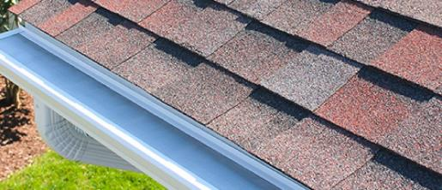
Sector D: Asphalt Paving & Roofing Materials & Lubricant Mfg.
SIC Codes: 2951, 2952, 2992, 2999
Monthly site inspections

Slide 18
Sector F: Primary Metals
SIC Codes: 3312-3317, 3321-3325, 3331-3339, 3341, 3351-3357, 3363-3369, 3398, 3399
Quarterly site inspections, with documentation of specific areas and activities (as applicable to your site)

Slide 19
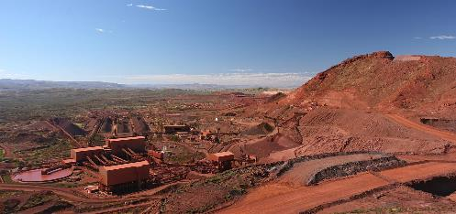
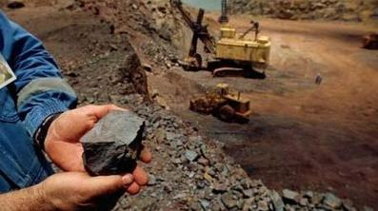
Sector G: Metal Mining (Ore Mining and Dressing)
SIC Codes: 1011, 1021, 1031, 1041, 1044, 1061, 1081, 1094, 1099
Active mining sites: Monthly site inspections
Inactive mining sites: Quarterly site inspections

Slide 20
Sector H: Coal Mines & Coal Mining Related Facilities
SIC Codes: 1221, 1222, 1231, 1241
US Office of Surface Mining (OSM) – Surface Mining Control and Reclamation Act (SMCRA) requirements must be followed. Partial monthly site inspections & complete quarterly site inspections.
www.osmre.gov/lrg/docs/SMCRA.pdf

Slide 21
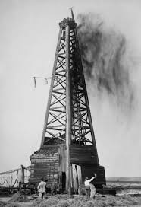
Sector I: Oil & Gas Extraction
SIC Codes: 1321, 1389
Erosion & sediment controls, either:
Weekly or
Bi-weekly AND within 24 hours of 0.5” or greater rain event
Inactive sites must be inspected at least annually

Slide 22
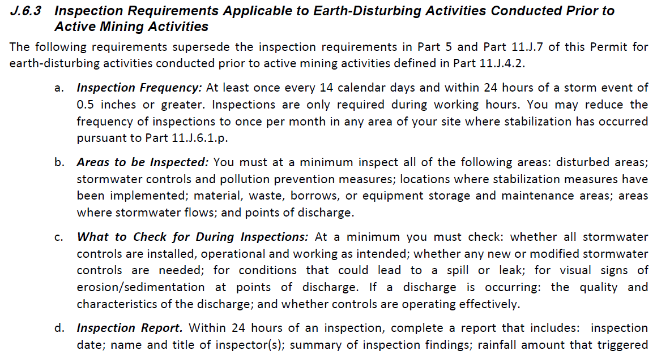
Sector J: Mineral Mining & Dressing
SIC Codes: 1411, 1422, 1423, 1429, 1442, 1446, 1455, 1459, 1474, 1475, 1479, 1481, 1499
Inspection frequencies vary, depending on site conditions.
Activities prior to active mining: Bi-weekly AND within 24 hours of 0.5” or greater rain event.
Monthly inspections for sites discharging to impaired waters.
Otherwise, Quarterly unless inaccessible.

Slide 23
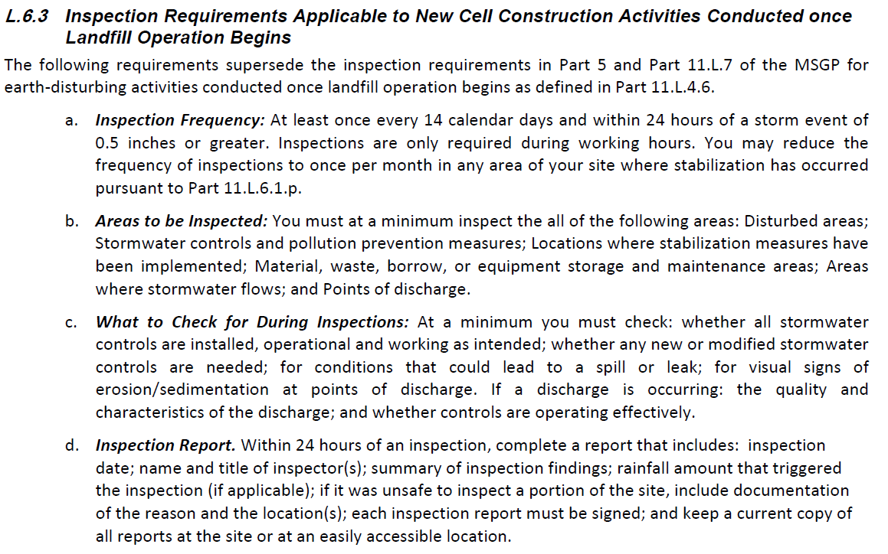
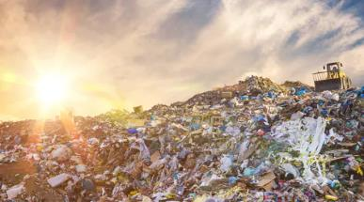
Sector L: Landfills, Land Application Sites & Open Dumps
Activity Code: LF
Inspection frequencies vary, depending on site conditions.
New cells: Bi-weekly AND within 24 hours of 0.5” or greater rain event.
Active sites: weekly.

Slide 24
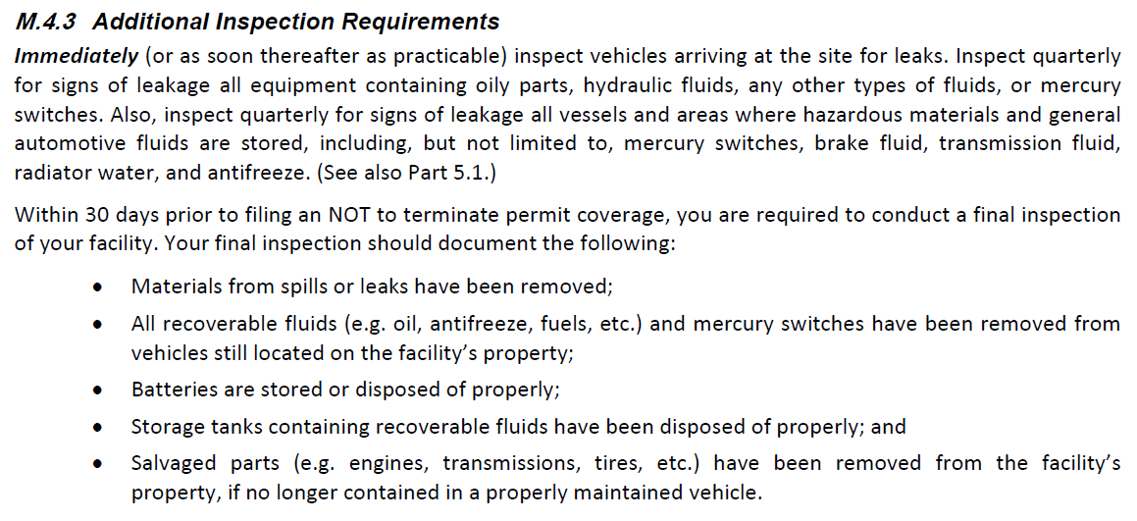
Sector M: Automobile Salvage Yards
SIC Code: 5015
Inspect arriving vehicles immediately.
Site inspections: Quarterly
Final inspection of site before filing an NOT to terminate coverage.

Slide 25
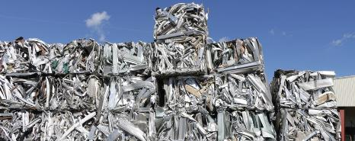
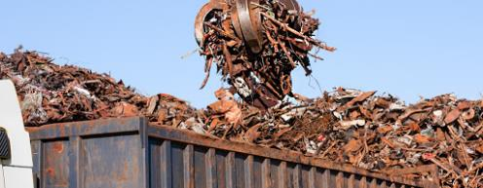
Sector N: Scrap Recycling Facilities
SIC Code: 5093
Quarterly inspections, with special attention to specific areas.

Slide 26
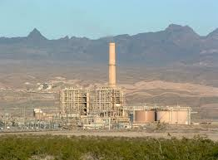
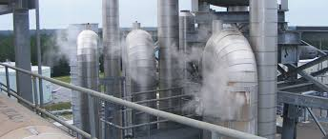
Sector O: Steam Electric Generating Facilities
Activity Code: SE
Monthly inspections, with special attention to specific areas.

Slide 27
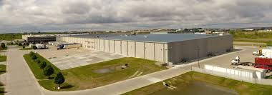
Sector P: Land Transportation & Warehousing
SIC Codes: 4011, 4013, 4111-4173, 4212-4231, 4311
Quarterly inspections, with special attention to specific areas.

Slide 28
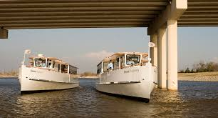
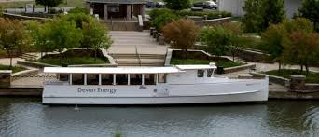
Sector Q: Water Transportation
SIC Codes: 4412-4499
Quarterly inspections, with special attention to specific areas.

Slide 29
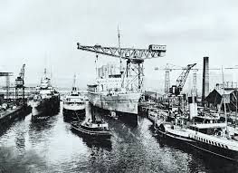
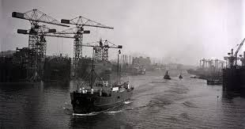
Sector R: Ship and Boat Building or Repairing Yards
SIC Codes: 3731, 3732
Quarterly inspections, with special attention to specific areas.

Slide 30
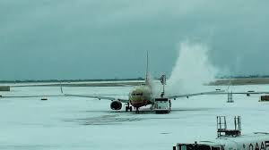
Sector S: Air Transportation
SIC Codes: 4512, 4513, 4522, 4581
Weekly inspections during deicing season
Otherwise, quarterly inspections

Slide 31
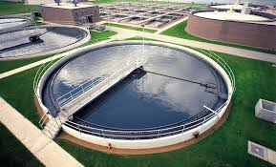
Sector T: Treatment Works
Activity Code: TW
Quarterly inspections, with special attention to specific areas.

Slide 32
Sector U: Food & Kindred Products
SIC Codes: 2011-2015, 2021-2026, 2032-2038, 2041-2048, 2051-2053, 2061-2068, 2074-2079, 2082-2087, 2091-2099, 2111-2141
Quarterly inspections, with special attention to specific areas.

Slide 33
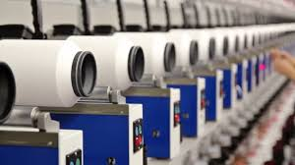
Sector V: Textile Mills, Apparel & Other Fabric Product Mfg., Leather & Leather Products
SIC Codes: 2211-2299, 2311-2399, 3131-3199
Monthly inspections, with special attention to specific areas.

Slide 34
Sector AA: Fabricated Metal Products
SIC Codes: 3411-3499, 3911-3915
Quarterly inspections, with special attention to specific areas.

Slide 35
Site Inspection Documentation
DEQ templates can be found here:
www.deq.ok.gov/water-quality-division/wastewater-stormwater/stormwater-permitting/okr05-industrial-stormwater

Slide 36
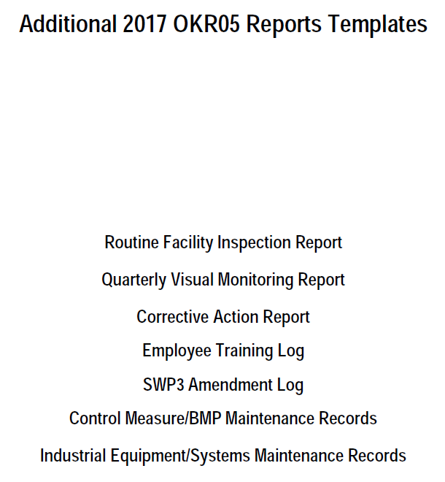
DEQ Reports Templates

Slide 37
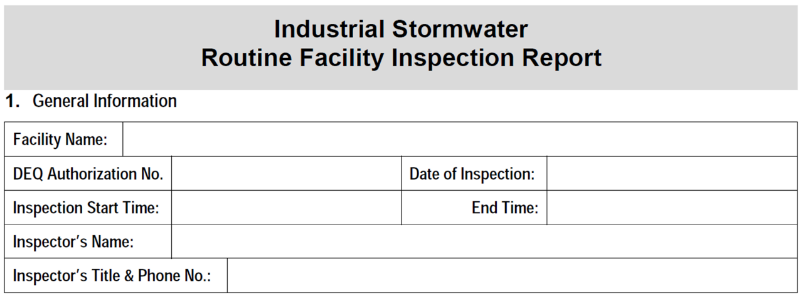
Routine Facility Inspection Report – page 1
The Business – OKC Office
OKR059999/SWI-2015-00352
01/15/2017
9:15am
10:15am
Mr. Team Leader
EHS Coordinator, 405-797-3546

Slide 38
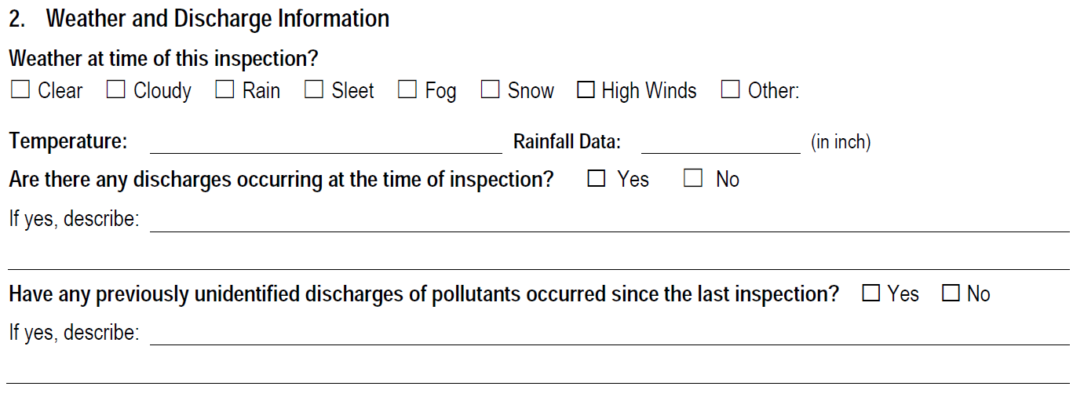
Routine Facility Inspection Report – page 1
73 º F
0.47”
Slow, steady rain since 3am, runoff appears clear and clean.

Slide 39
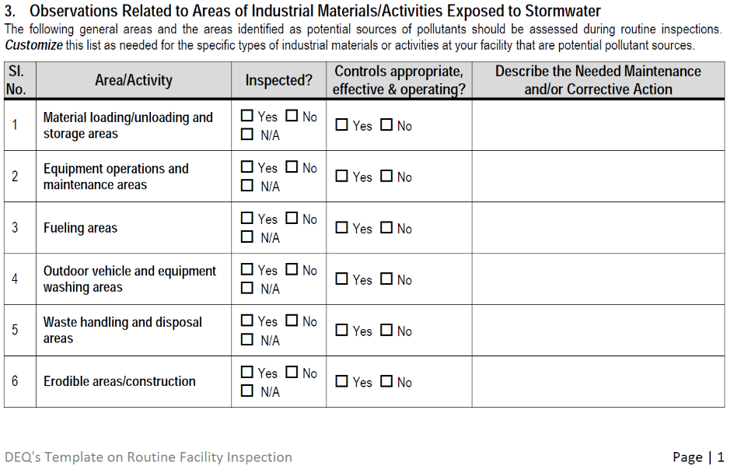
Routine Facility Inspection Report – page 1
Need to sweep up metal shavings

Slide 40
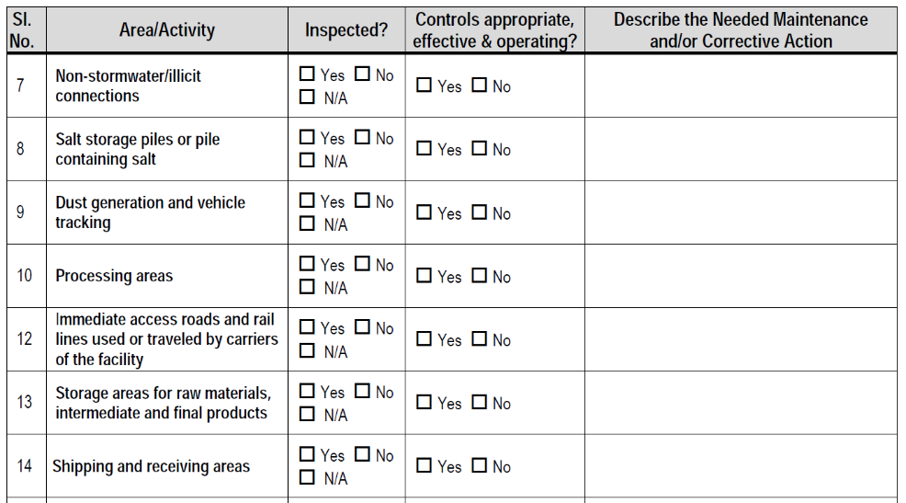
Routine Facility Inspection Report – page 2

Slide 41
Routine Facility Inspection Report – page 2
Metal pipe racks, stock material

Slide 42
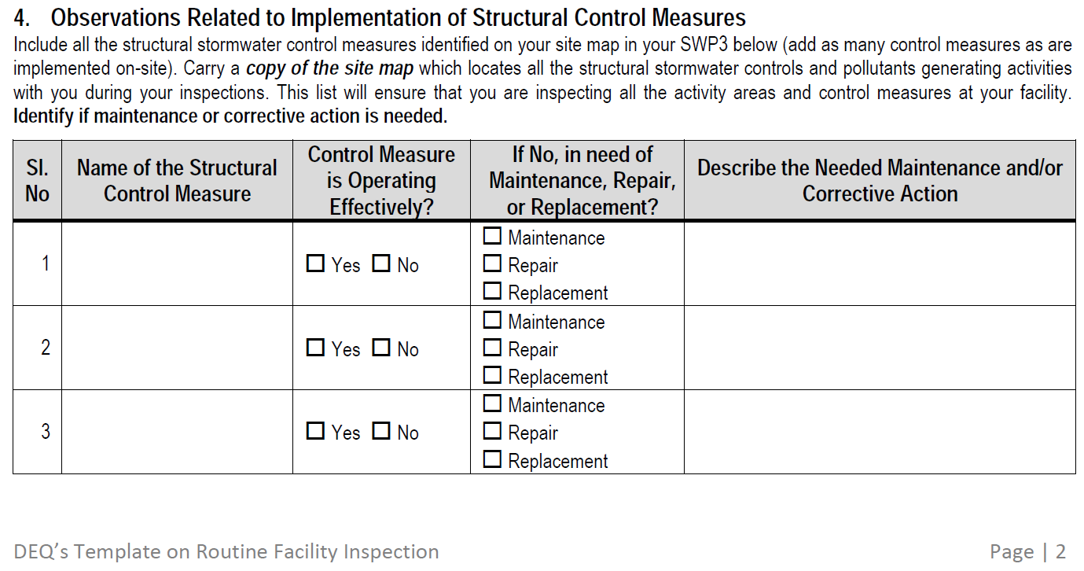
Routine Facility Inspection Report – page 2
Metal awning
Compost soxx

Slide 43
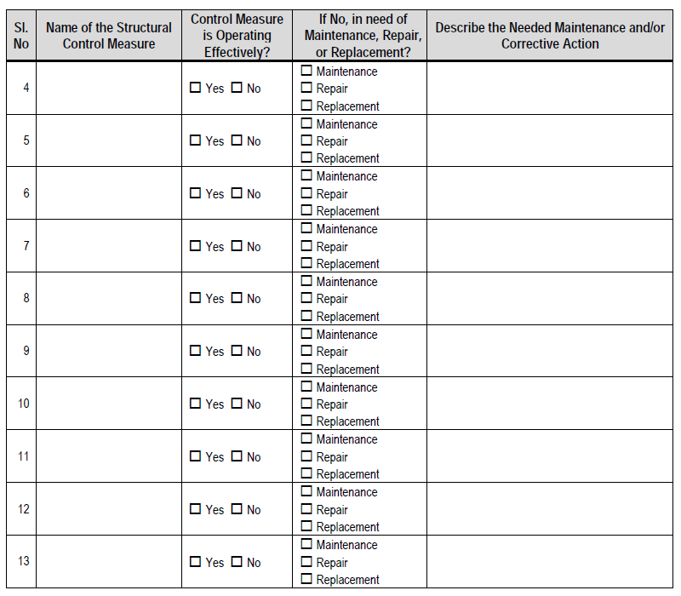
Routine Facility Inspection Report – page 3
If you have more Structural BMPs, inspect and list them here!

Slide 44
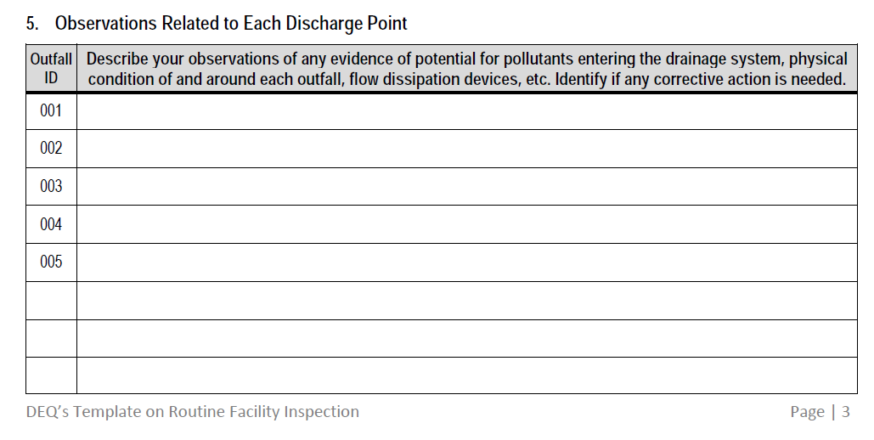
Routine Facility Inspection Report – page 3
Outfall appears clean, stable, and flowing efficiently.

Slide 45
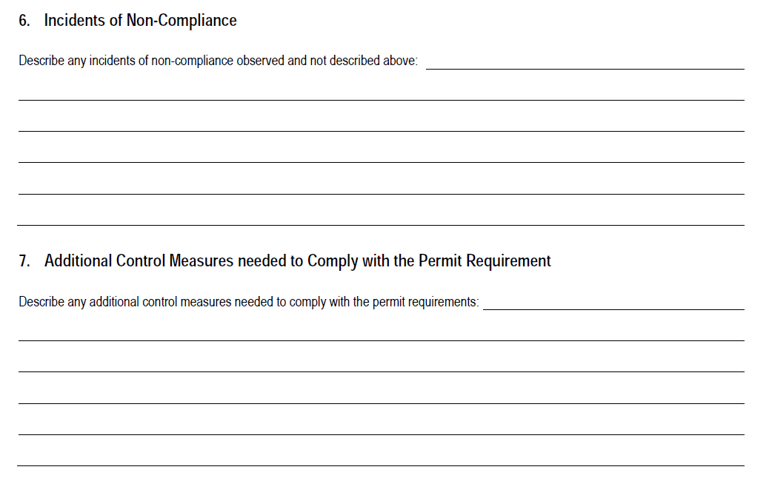
Routine Facility Inspection Report – page 4
Metal shavings need cleaned up around
scrap bin. Employees state that incident occurred during bin swapout. Need to check area daily.
No additional controls needed.

Slide 46
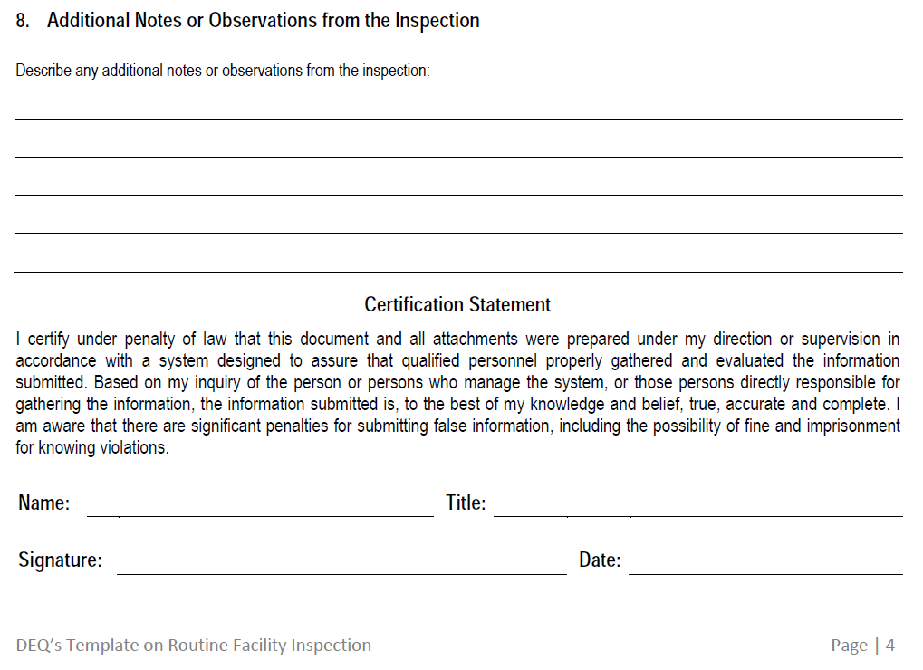
Routine Facility Inspection Report – page 4
No other notes/observations at this time.
Mr. Team Leader
EHS Coordinator
Mr. Team Leader
01/15/2017

Slide 47
General Guideline for Site Inspections
Always available on your Workshop CD’s,
or ask your inspector for a copy

Slide 48
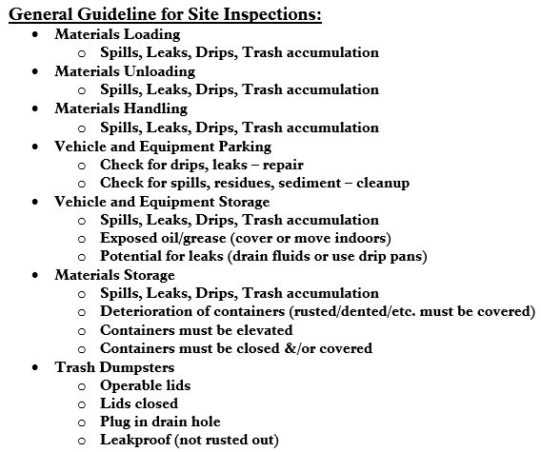
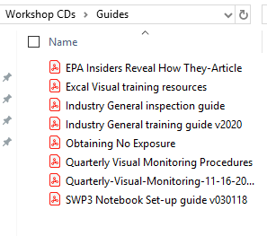
Available on Workshop CDs

Slide 49
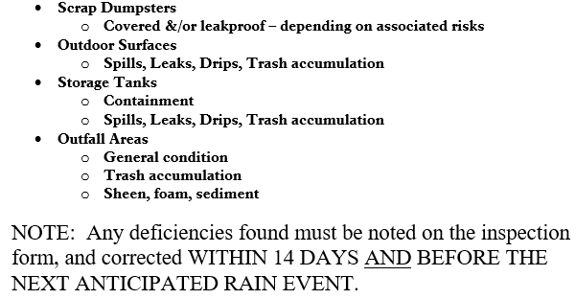
Available on Workshop CDs
General Guideline for Site Inspections, continued:

Slide 50
Site Examples of What to Look For
(These are also things Regulators look for)

Slide 51
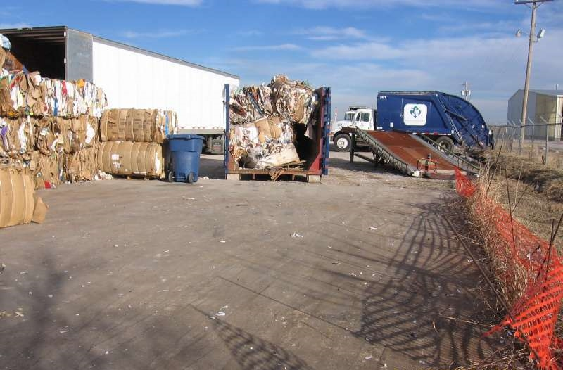
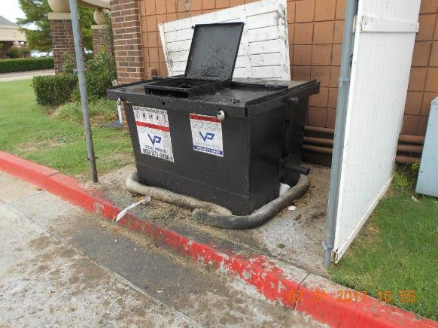
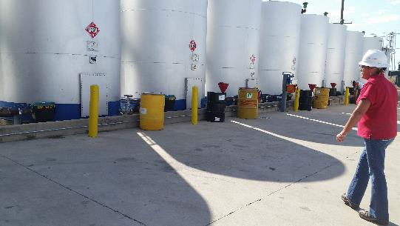
Loading & Unloading Areas
Spills, leaks, drips & trash accumulations

Slide 52
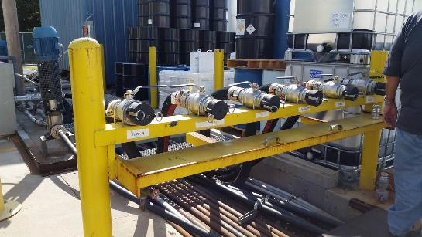
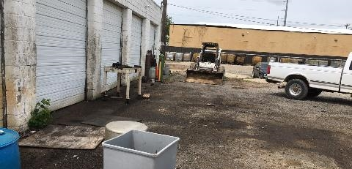
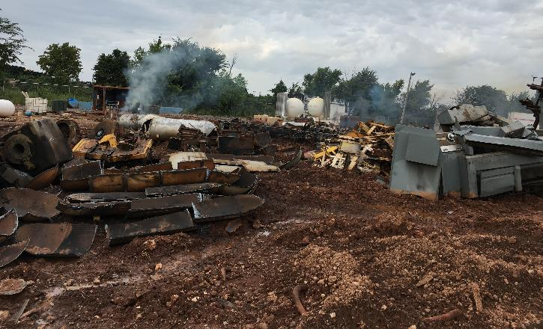
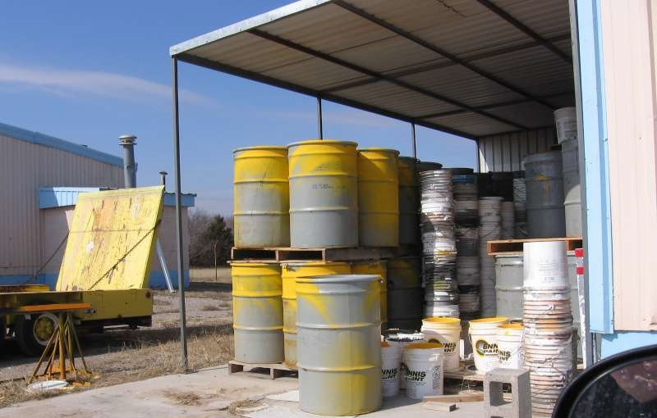
Materials Handling
Spills, leaks, drips & trash accumulations
Other concerns?

Slide 53
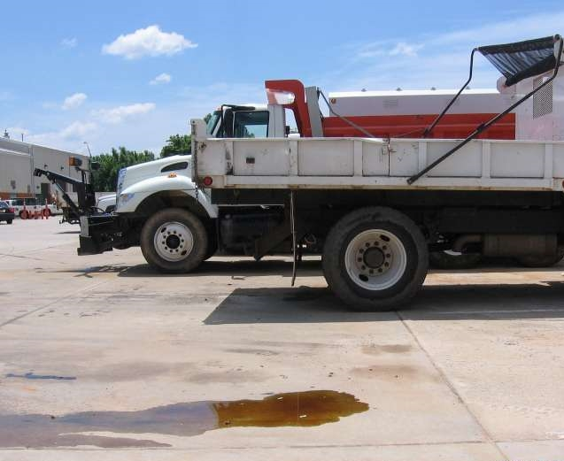
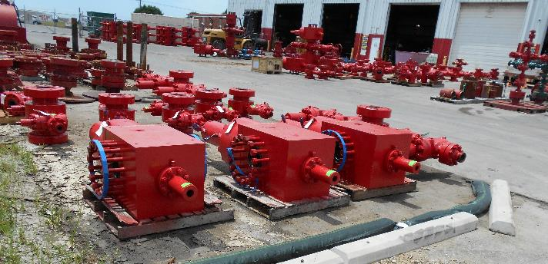
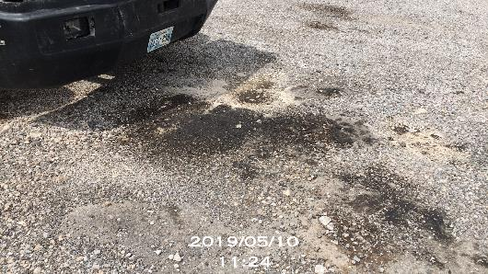
Vehicles & Equipment: Parking & Storage Areas
Spills, leaks, drips & trash accumulations
Exposed oil/grease/mud/dirt
Potential for leaks (drain fluids or use drip pans)

Slide 54
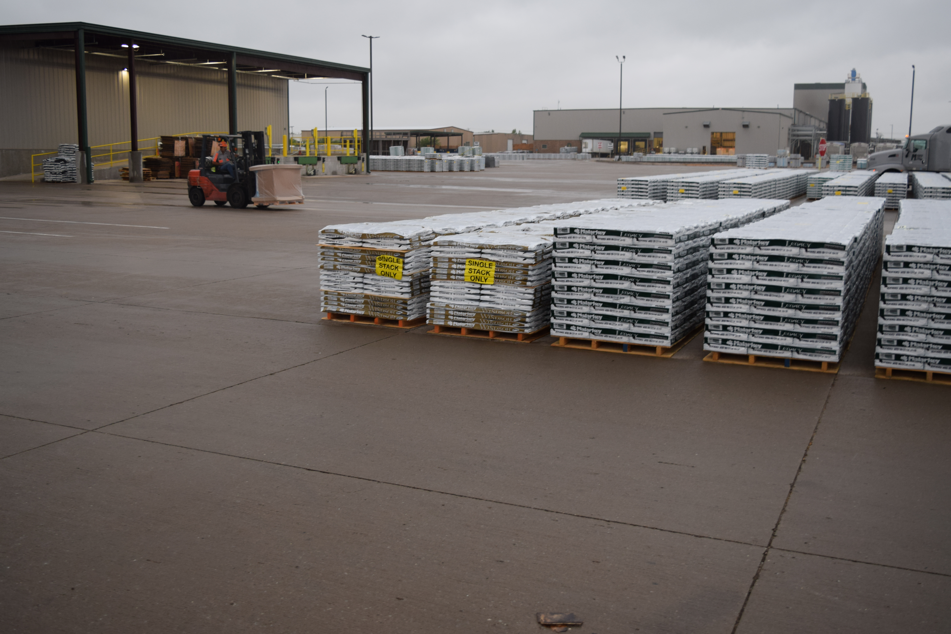
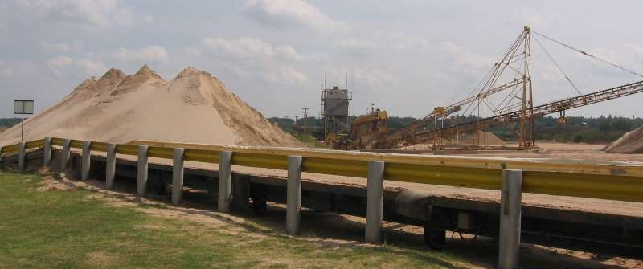
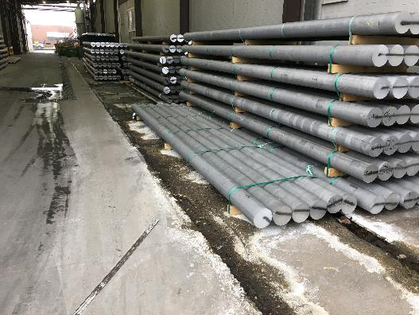
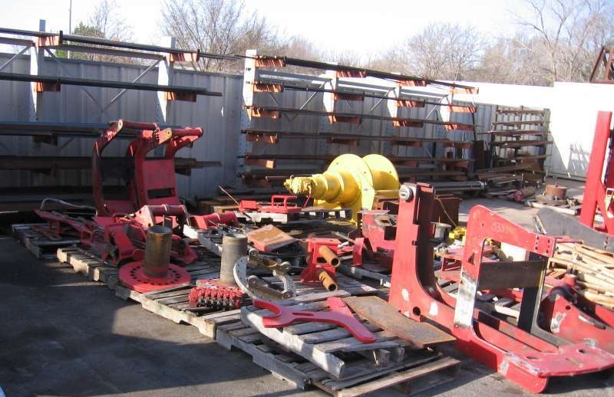
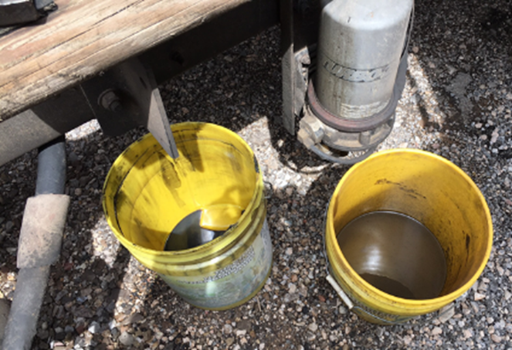
Materials Storage Areas
Spills, leaks, drips & trash accumulations
Deterioration of containers
Open, rusted, dented must be covered
Containers elevated, closed, covered
Clean, neat and tidy work areas are best!

Slide 55
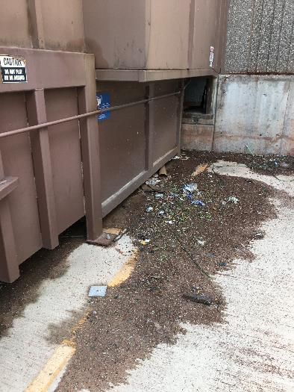
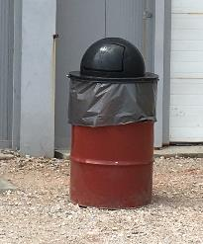
Trash, Scrap & Recycling Containers
Operational, closed lids
Drain plug, leakproof (not rusted out), covered

Slide 56
Outdoor Surfaces & Fence Lines
Spills, leaks, drips & trash accumulations

Slide 57
Chemical Storage
Secondary containment on tanks
Spills, leaks, drips & trash accumulations
Deterioration of containers
Rusted, dented must be covered
Containers elevated, closed, covered
Spill kits nearby

Slide 58
Best Practices & Controls
Operational, functional, in place
Appropriate, sufficient?

Slide 59
Outfall Areas
General condition, trash accumulation
Sheen, foam, sedimentation/erosion

Slide 60
Record Retention

Slide 61
Record Retention
From the OKR05:
Keep all records at least 3 years from the date that your permit coverage expires or is terminated.

Slide 62
DEQ FAQ’s
Routine Facility Inspection
www.deq.ok.gov/water-quality-division/wastewater-stormwater/stormwater-permitting/okr05-industrial-stormwater/

Slide 63
Routine Facility Inspection – DEQ FAQ’s
www.deq.ok.gov/water-quality-division/wastewater-stormwater/stormwater-permitting/okr05-industrial-stormwater/

Slide 64
Routine Facility Inspection – DEQ FAQ’s
www.deq.ok.gov/water-quality-division/wastewater-stormwater/stormwater-permitting/okr05-industrial-stormwater/

Slide 65
Routine Facility Inspection – DEQ FAQ’s
www.deq.ok.gov/water-quality-division/wastewater-stormwater/stormwater-permitting/okr05-industrial-stormwater/

Slide 66
Routine Facility Inspection – DEQ FAQ’s
www.deq.ok.gov/water-quality-division/wastewater-stormwater/stormwater-permitting/okr05-industrial-stormwater/

Slide 67
For more information: www.okc.gov/SWQ
www.deq.ok.gov
www.epa.gov
Questions? email: rebecca.dallen@okc.gov
Notes:
Image credit: Getty Images

